Slide 1





cordap.org
Coral Accelerator Program (CAP) 2024
Concept Note (Pre-Proposal) Webinar - September 18th 2024

Slide 2
Welcome to the CORDAP Coral Accelerator Program (CAP) Webinar
Please submit questions through Zoom questions or chat; if we do not get to all questions today, we will update the FAQ with the outstanding ones.
We will answer questions at the end of the presentation.
Please read the call documents carefully before developing your submission – it is critical to address the objectives of the call and ensure that you meet the criteria!
We will post this recording online to be shared with those who could not attend.
Please send any further queries to funding@cordap.org.
Notes:
Mention that we will record this and make it publicly available.

Slide 3





What is G20 CORDAP? - COral Research and Development Accelerator Platform
A G20 initiative focused on accelerating international research and development (R&D) targeting the most important knowledge gaps in coral conservation and restoration.
Launched during the Saudi Arabian G20 presidency, it is a not-for-profit foundation funded by voluntary contributions. Saudi Arabia’s contribution is $100M over 10 years– our target is $300M to invest in innovation for coral conservation.
CORDAP’s main activity is the funding, management, and execution of coordinated, collaborative, and targeted global R&D programs for coral conservation and restoration.
CORDAP has an Initiative Governing Committee (IGC) composed of member countries and coral organizations and an international Scientific Advisory Committee (SAC).
King Abdullah University of Science & Technology (KAUST) resources, hosts, and supports all administration– 100% of all contributions go to the funded coral conservation projects.

Slide 4
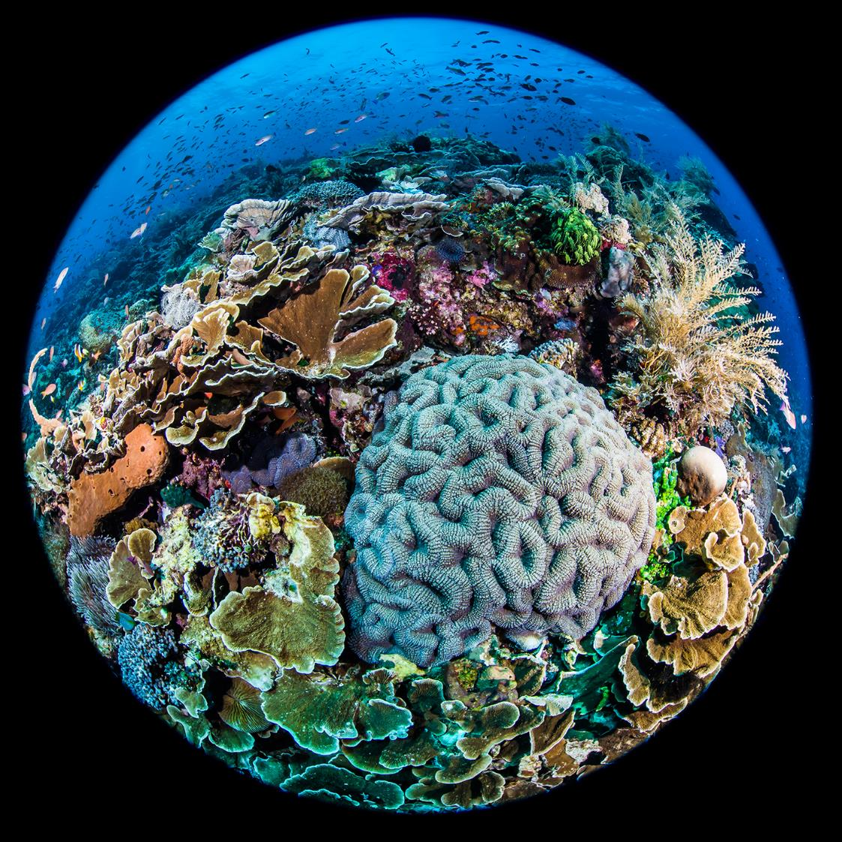
CORDAP – Goals and Objectives
Fund and deliver the best novel scientific and technological solutions to conserve and restore corals and reefs
Connect existing national, regional, and international R&D programs
a
b
Develop and share novel scientific tools
g
c
Support a gender-balanced, transdisciplinary global community of scientists, technologists, and innovators to achieve the goals
Facilitate access to information & research facilities
f
d
e
Engage the R&D capacity of the private sector with the goals
Provide advanced R&D training to scientists from developing and least developed countries
Ambitious, inclusive, and unique– a global effort including all tropical, shallow, and deep-water corals:
No Corals Left Behind

Slide 5
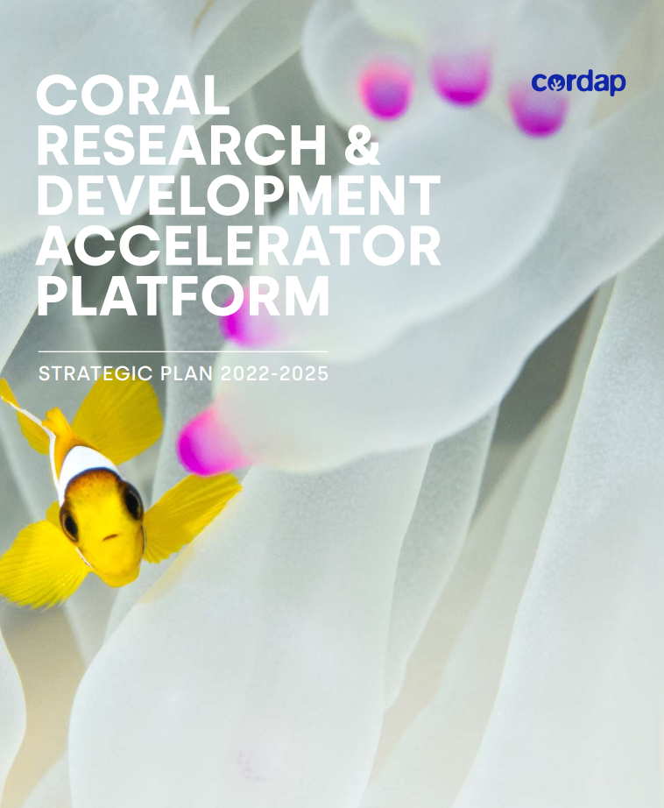
CORDAP – Strategic Plan for 2022-2025
The plan:
identifies how CORDAP will deliver the program,
describes the approaches and types of projects it funds,
focuses on the most pressing investment needs for directing the program over its first three years of operation, and
presents areas where R&D roadmaps should be developed before significant investment.
CORDAP will invest in novel, early-phase ideas through to final proof-of-concept development and testing.
Available at cordap.org
NOTE: Use the project types and priority areas outlined in the call document (not those in the Strategic Plan), as they have been updated.

Slide 6

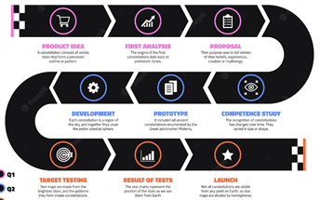
CORDAP’s Coral Accelerator Program (CAP): Objectives and Goals
CORDAP will deliver:
  technologies, methods, and processes that can be applied in conservation and restoration efforts across the world through existing national and international efforts.
  innovation crucial to filling the significant gap between current and required global capabilities.
Projects funded under this program are expected to lead to significant discoveries, innovations, and improvements over the current state-of-the-art.
Proposals transcending different disciplines and fields, and including end- users in the research, design, and development of projects, are strongly encouraged- identify suitable partners and groups that can further develop and deploy the proposed technologies.

Slide 7
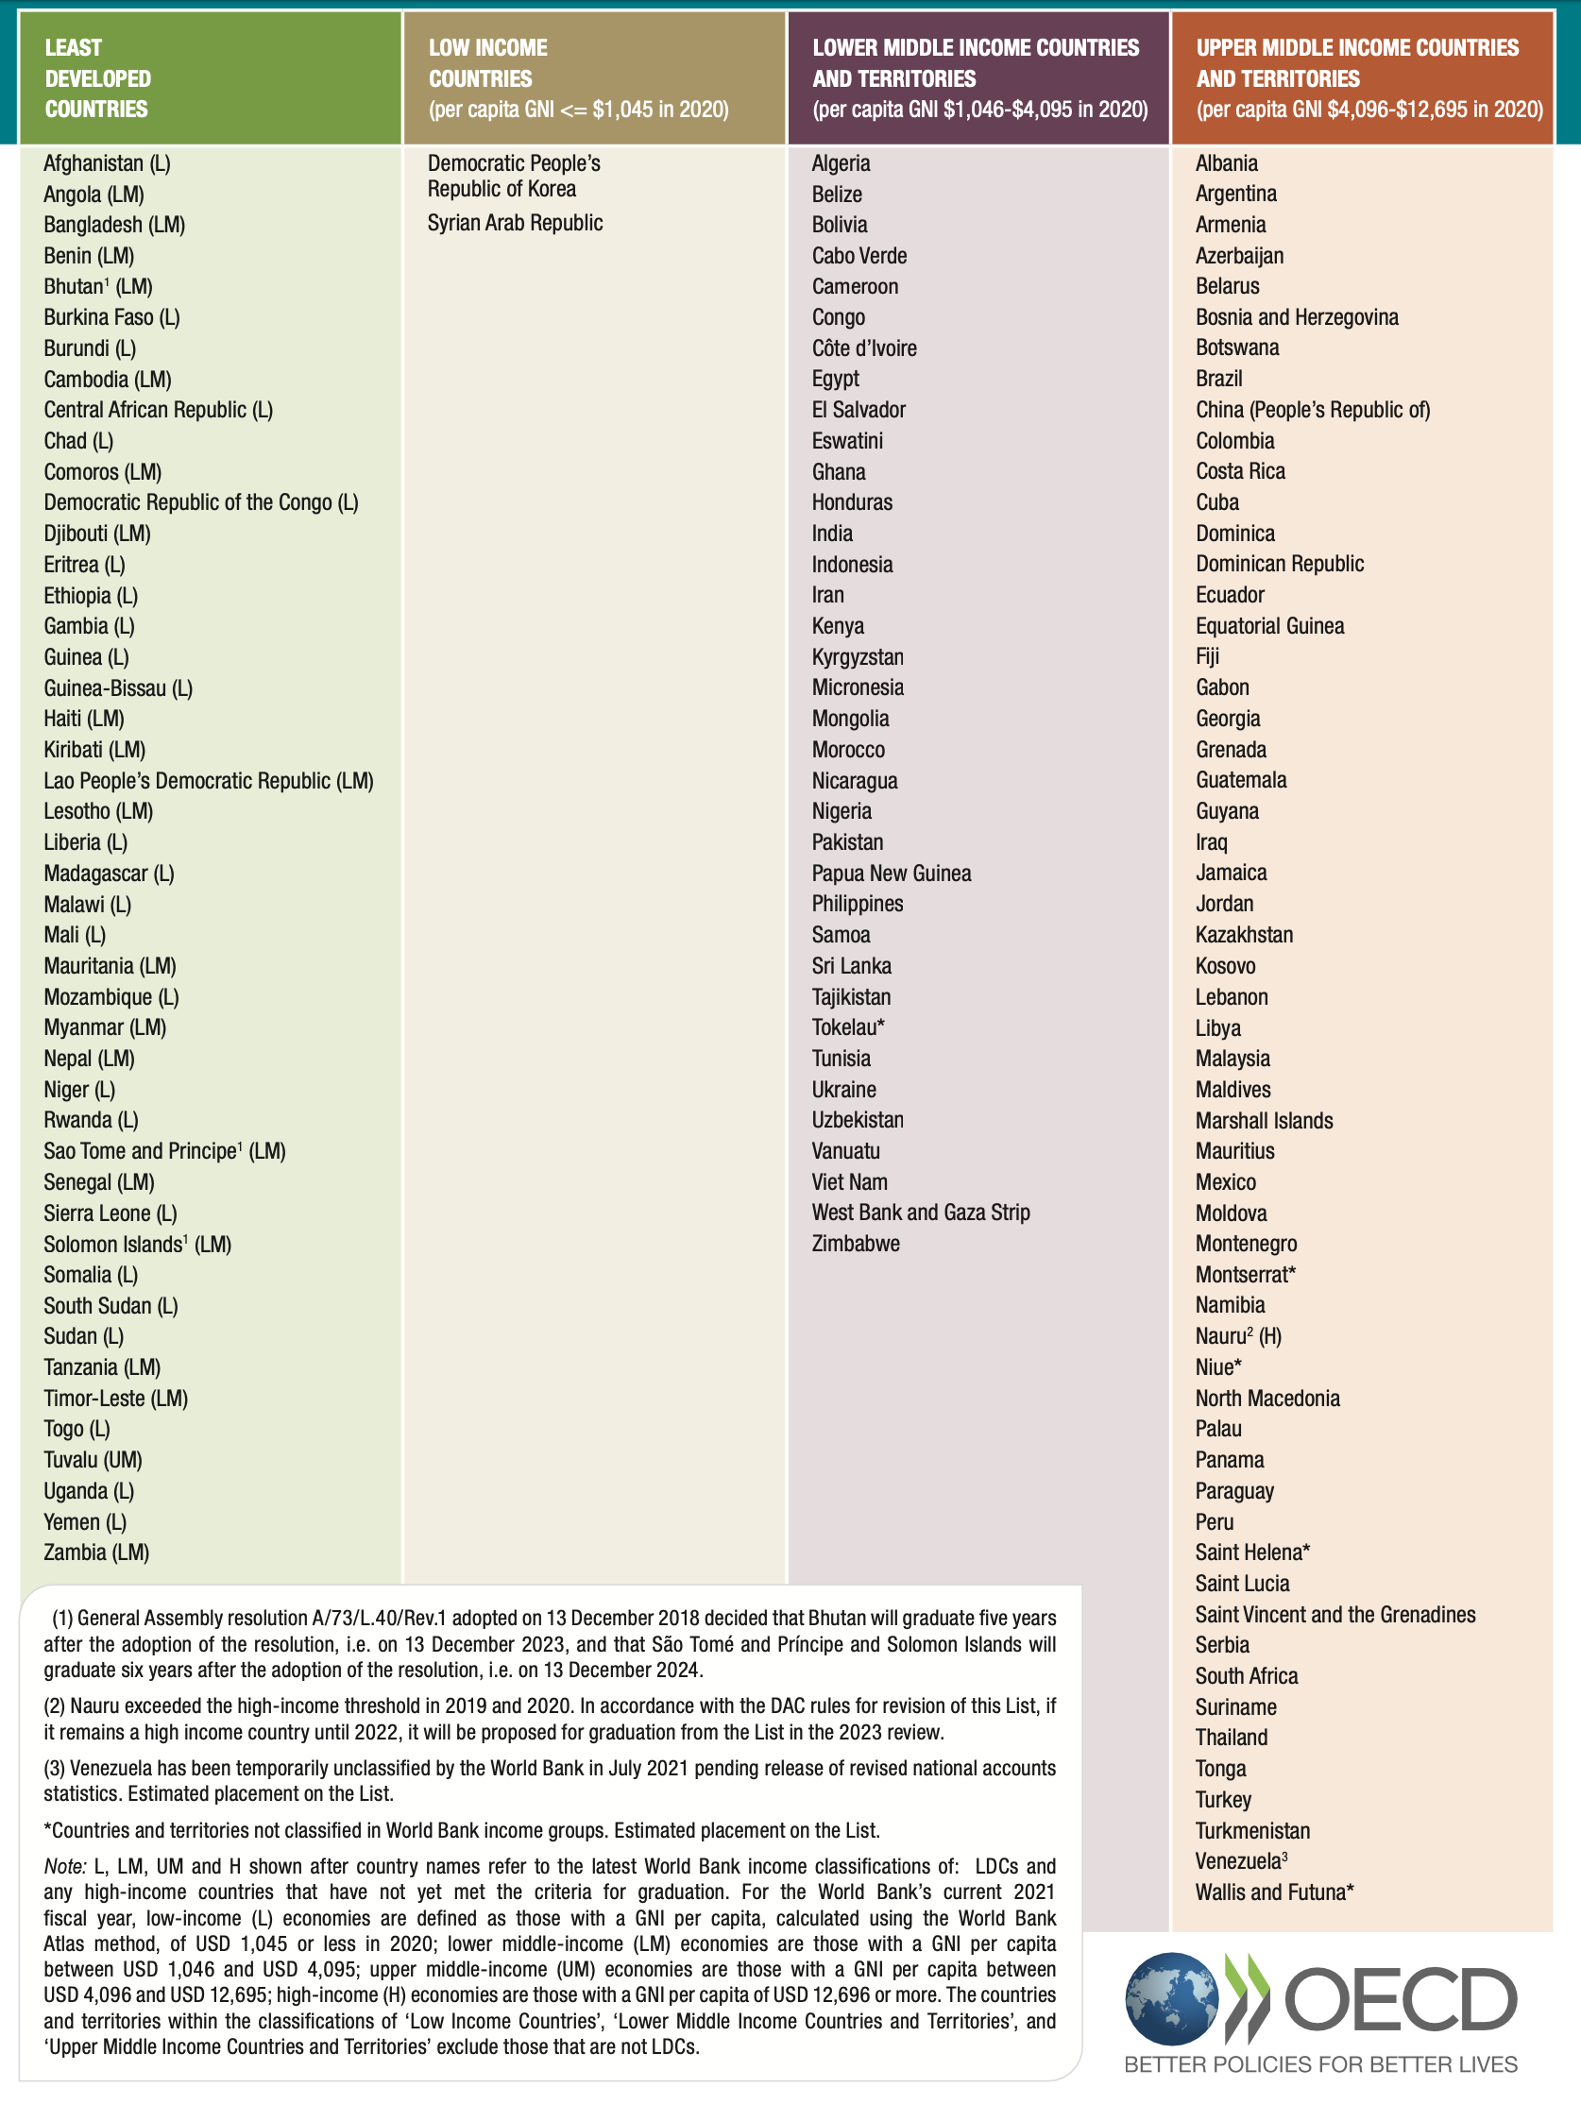
Important:
Must have a developing country partner.
Use the OECD list➔
Note that “upper middle income” countries are eligible.

Slide 8
CORDAP has funded 22 projects to date
225 proposals received (>1,000 applicants)
  Funding 28M/270M requested (~10% funding rate)
Funds sent to 33 countries:
  19 developing (LMIC)+14 developed
~50/50% developed/developing country breakdown

Slide 9
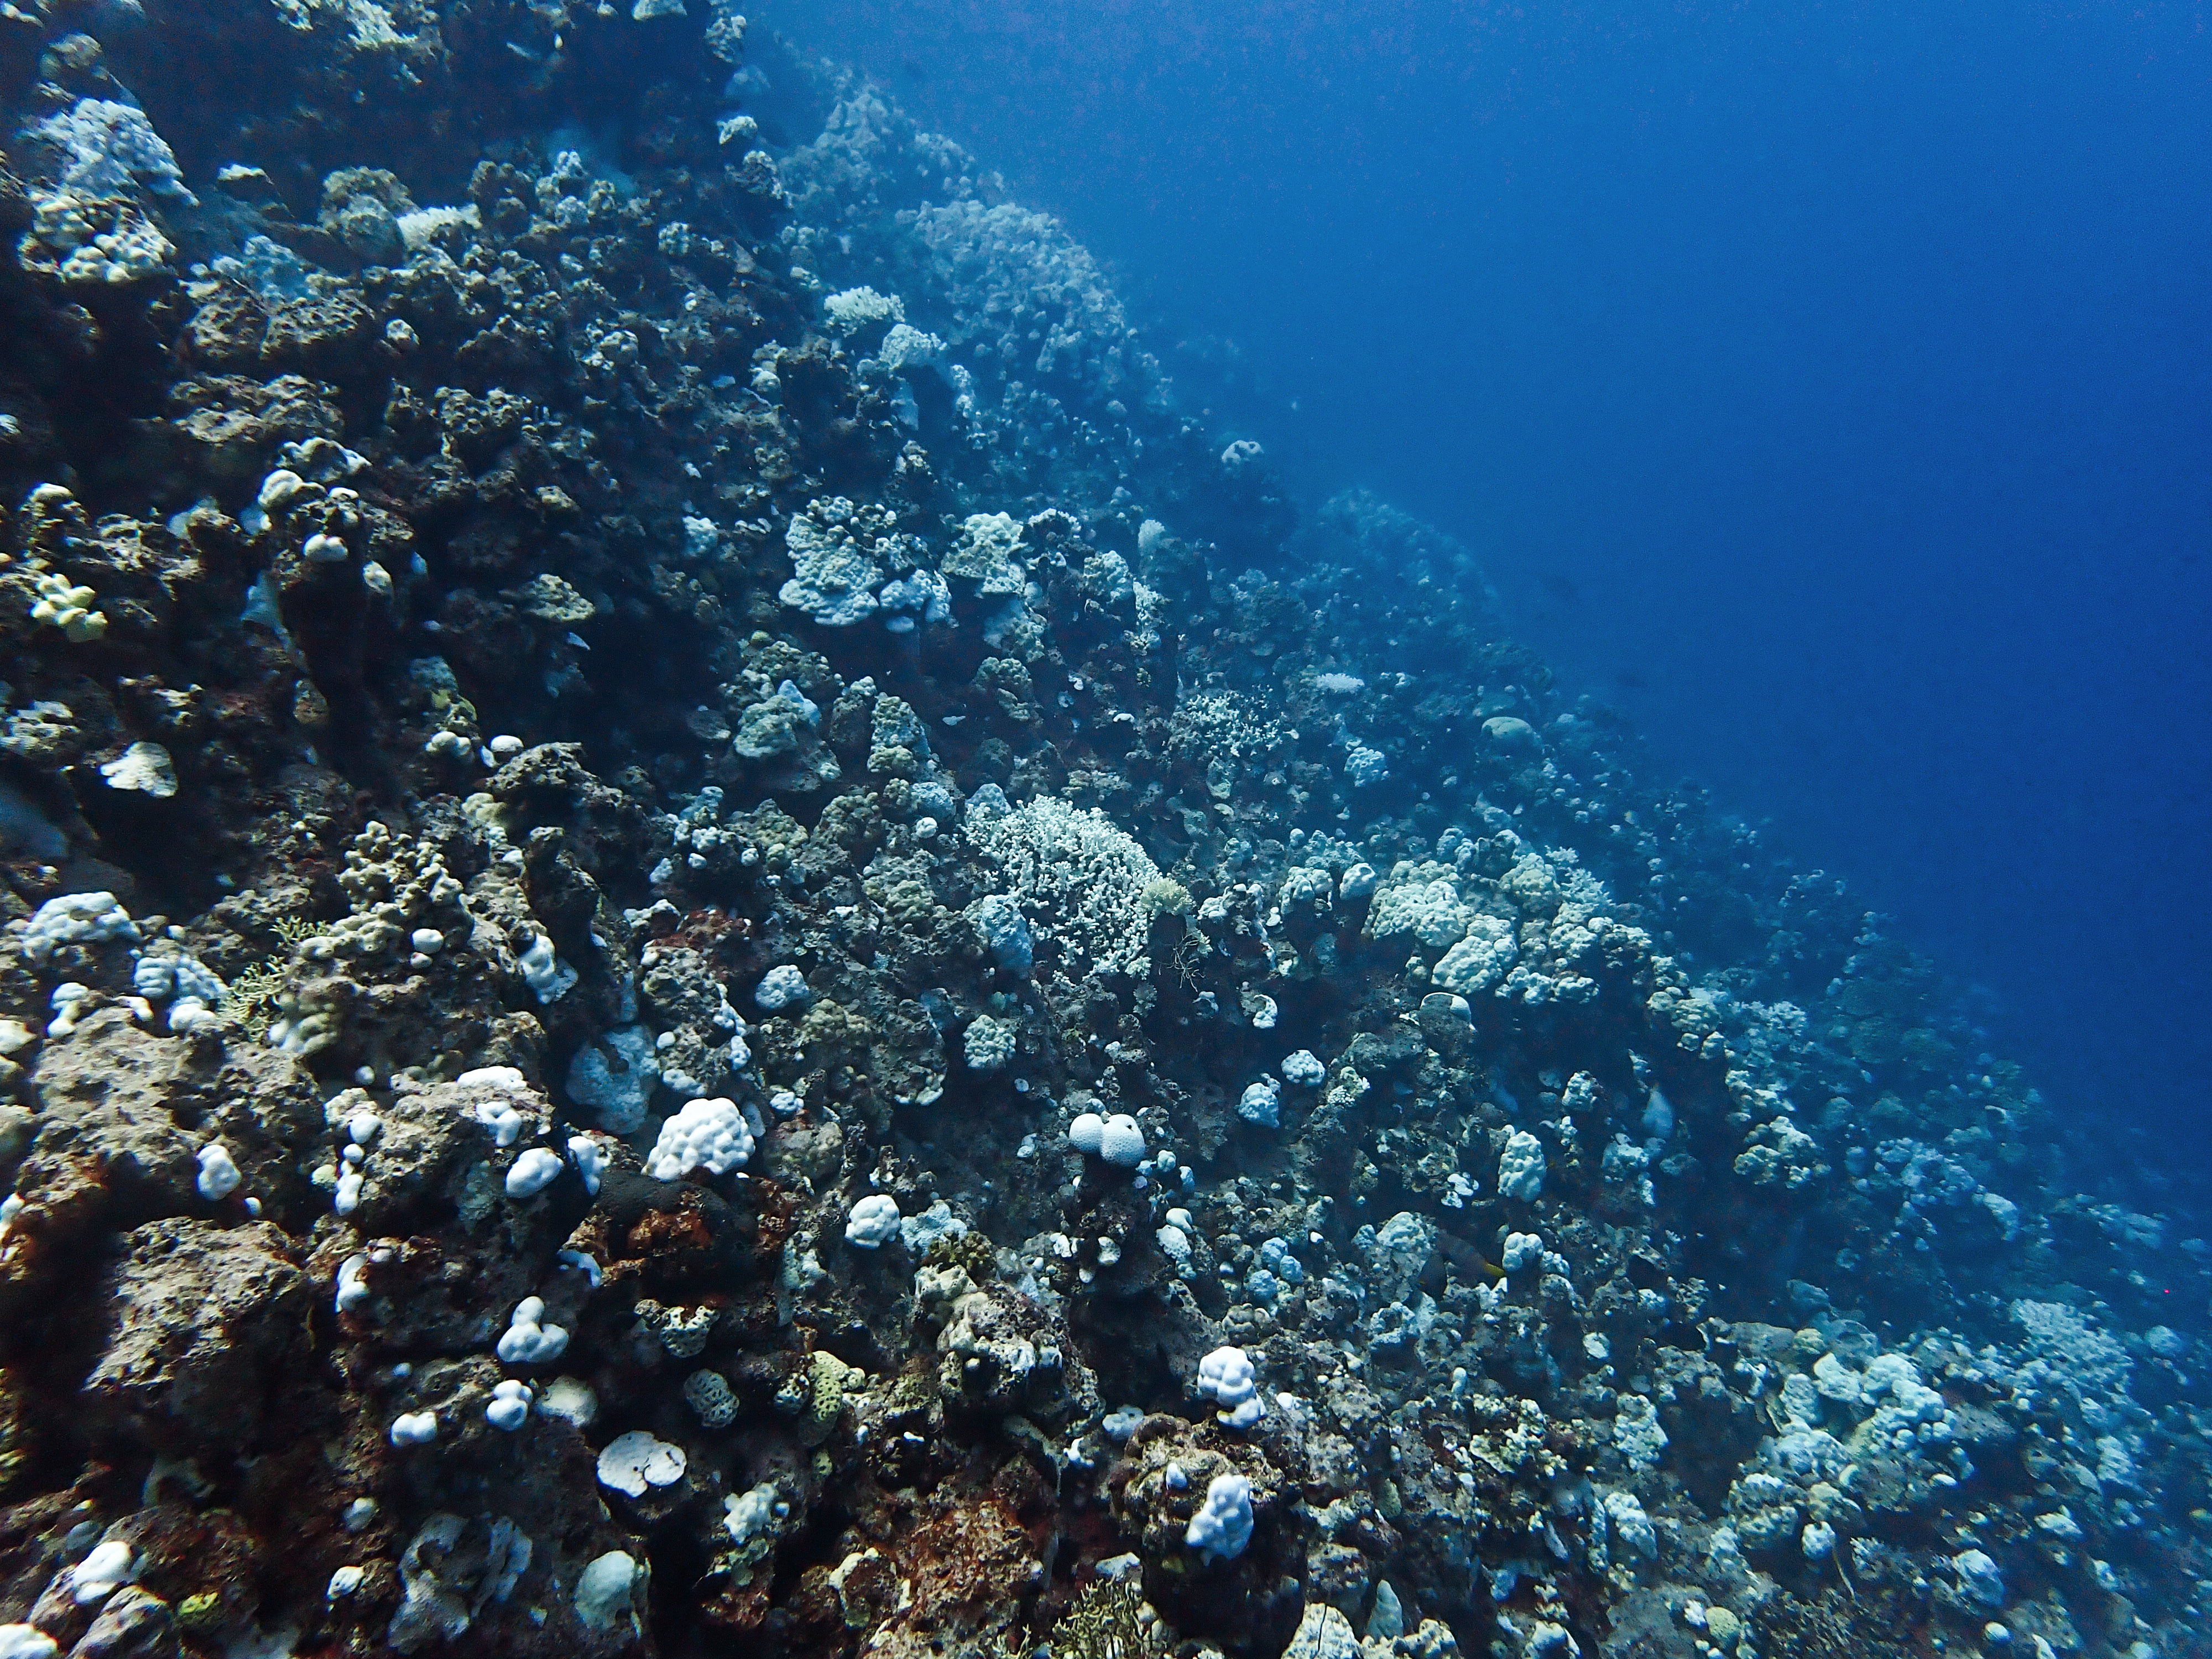
CORDAP’s third call - CAP 2024
Red Sea bleaching (Aug. 2024)
This program will fund international collaborative research teams with impactful ideas in coral conservation and restoration.
Eligible projects can span across the full range of novel early-phase projects through to final proof-of-concept development and testing.
$1.5M per project – projects can run between one and three years in length.
Budget for 2024 call – approx. USD$8.5M
The first stage is the submission of a Concept Note (pre-proposal).

Slide 10
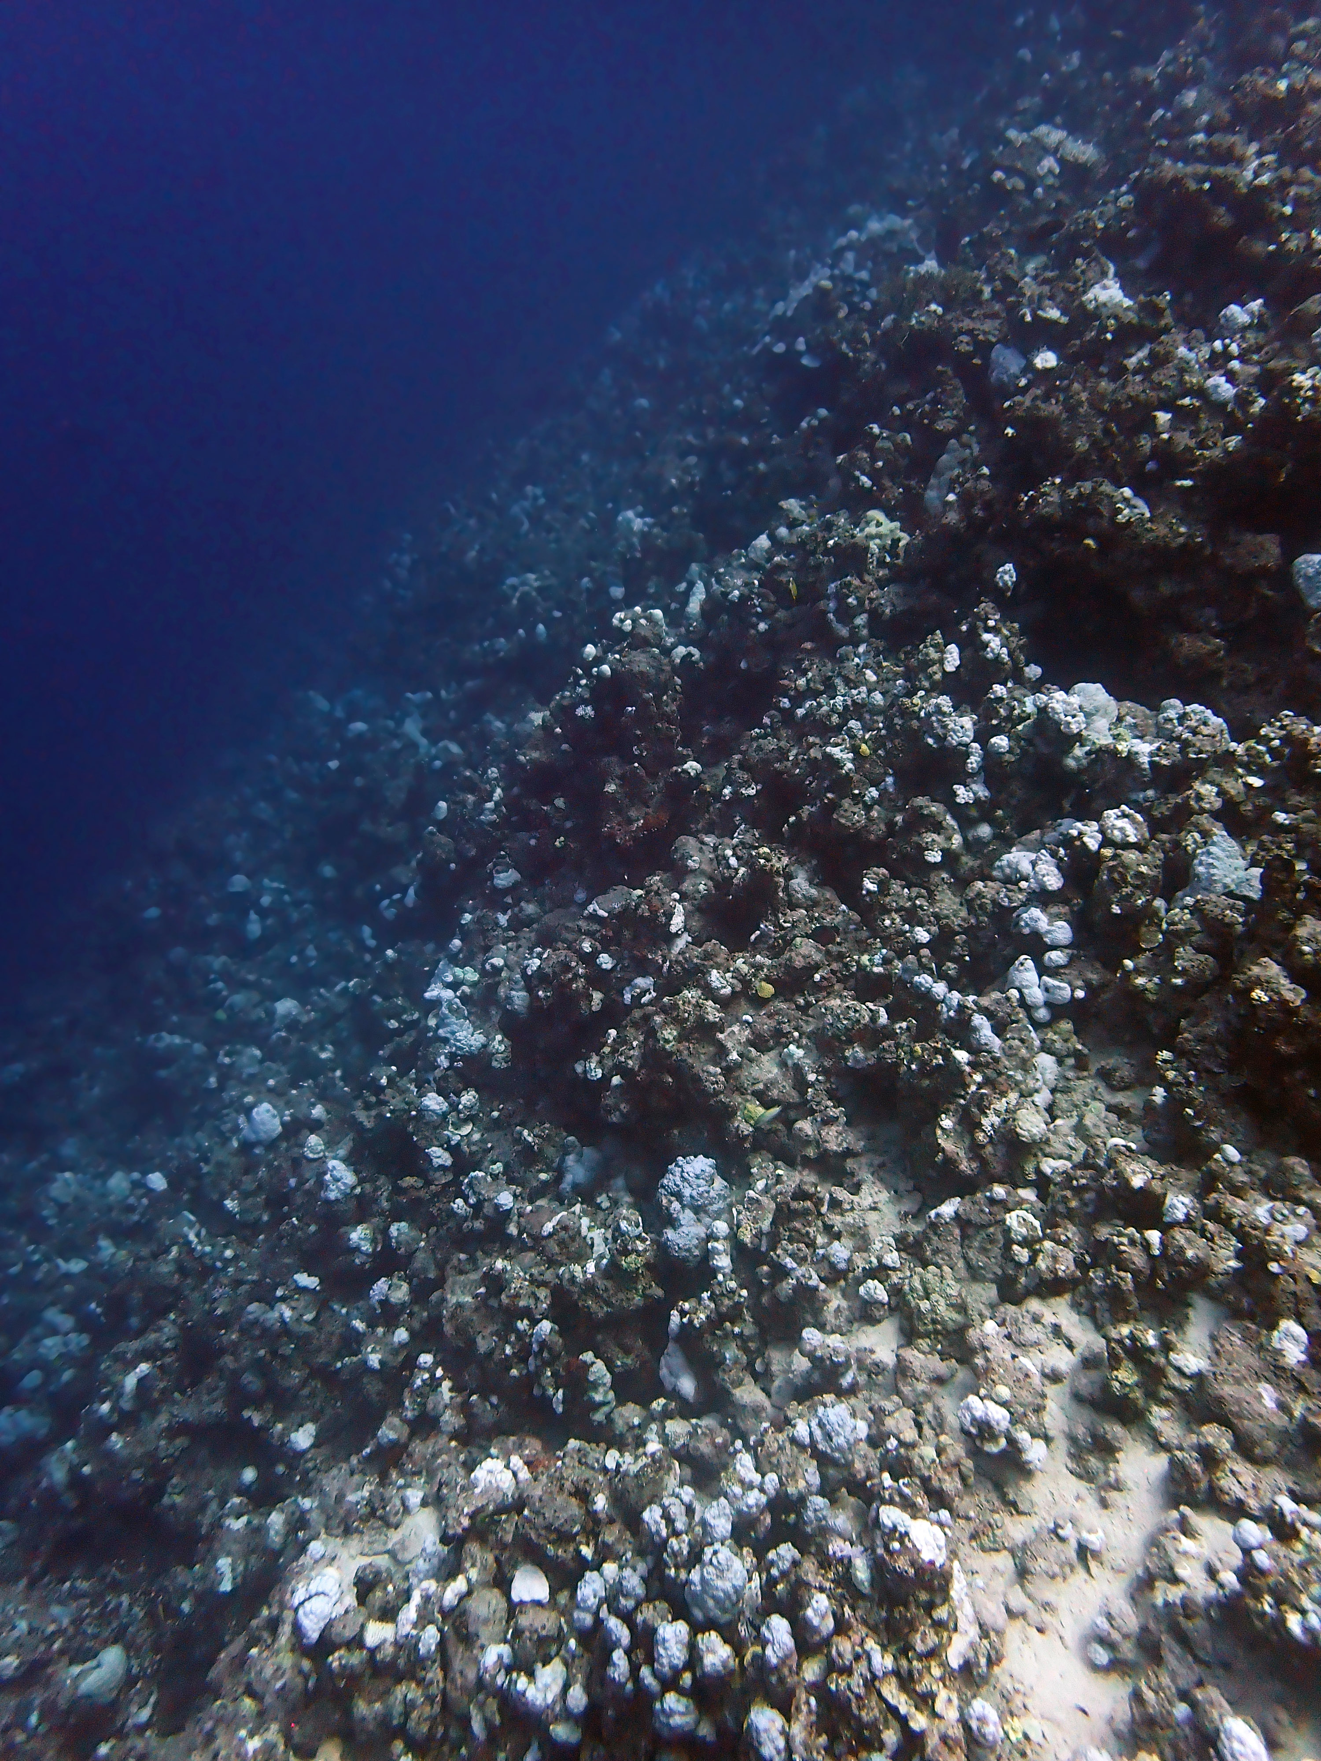
CORDAP CAP 2024– Key Dates
Launched on September 2nd – CALL NOW OPEN
Call webinars – Sept. 18th - 6am and 3pm UTC
Concept Note submission deadline: October 21st 5pm UTC
Anticipated notification/invitation to submit Full Proposal – late-December 2024
Anticipated funding notifications – July 2025
Jeddah (late August 2024)

Slide 11
CORDAP CAP – Project Types and Priority Areas
Call will support a wide range of project types:
Novel R&D projects
Improving or scaling up existing interventions
Translational R&D
Fundamental science to support implementation of interventions
Capacity development+local innovation and implementation
Priority Areas
1. Preservation and conservation of corals
2. Intervention planning, risk, and monitoring
3. Limiting mortality of early life stage corals
4. Methods to blend natural and artificial reef recovery
5. Developing country R&D methods
6. R&D capacity development
7. Assisted evolution of corals
8. Coral aquaculture
9. Cold-water corals
CORDAP has also been organizing a range of workshops with wide participation on specific topics that require further investigation before targeted investment.

Slide 12
Research themes

Slide 13
CAP Eligibility
An international collaborative program:
  Each proposal must comprise a minimum of three applicants (lead + two co-applicants).
  Each proposal must comprise applicants from at least two countries, one of which MUST be from a low- or middle-income country (based on most current OECD list).
All organization types are eligible (not-for-profit, for-profit, Gov, NGO, multilateral groups, etc.)
Applicants receiving funding must have the authority and independence to run the project within their organization.
See the FAQ document for further eligibility details, but briefly:
  An individual can only be Lead Applicant on one proposal and participate in up to a maximum of two additional proposals as Co-Applicant.
  An organization can only be the lead institution on up to two proposals but can be a participating organization on multiple proposals.
  If a for-profit organization wishes to submit as an applicant, then they must be willing to co-invest to the point that they are not making a profit.
  CORDAP is unable to make grants directly to individuals.
  There is no upper limit to the number of organizations in an application.

Slide 14
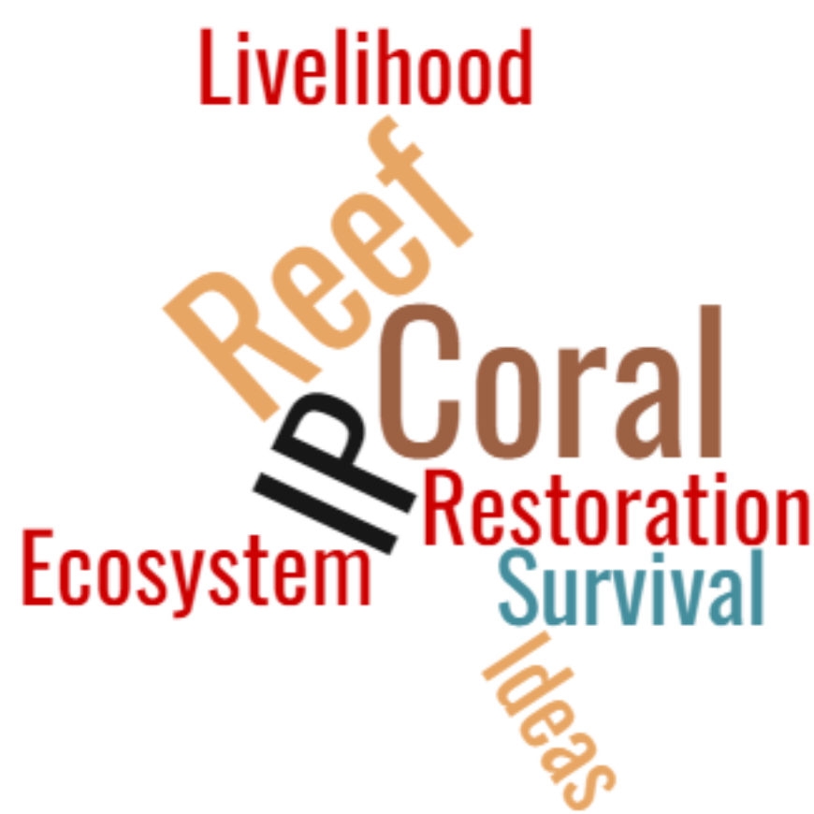

CORDAP Funding Policies
Intellectual property (IP)
  CORDAP does not seek to own any of the IP resulting from its funded activities. Ownership vests as agreed by the organizations collaborating on the project.
  Owners of IP resulting from CORDAP-funded activities must provide a free license for all commercial and non-commercial coral conservation and/or restoration use, including free license to any background IP upon which the project relies.
  CORDAP-funded developments and technologies should be made available and accessible at an affordable price to all coral conservation and restoration projects.
Open-access
  Publications, and underlying data, will be immediately, freely, and openly accessible to all.
  There should be no barriers to the re-use and dissemination of CORDAP-funded publications.
  CORDAP will pay necessary reasonable open-access publication fees (include in budget.).
  Data and software should be “Findable, Accessible, Interoperable, & Reusable (FAIR).”
  We are working on a web-based means of showcasing our funded protocols, technologies, and solutions (“Coral Solutions Hub”).

Slide 15
What’s in a Concept Note Submission?
A Concept Note, or pre-proposal, is a short statement of your project objectives, methodology, intended users, and estimated budget.
The narrative (3-page max.) will include an outline of:
Background: What is the problem you are trying to solve and why is this important?
How is it done today? What are the current limitations and what is new in your approach?
Strategy and work plan, including risks to success, who will do what, milestones, and estimated timeline
Expected outcomes: How will you know if the project is successful?
Impact and pathway-to-impact: Who will use the outcomes and how will they use them? How scalable are your results and can they be transferred to other regions? Will they be affordable?
Outline the intellectual property (IP) situation with the project: Does it rely on background IP? Is this background IP available and will it, and project IP, satisfy CORDAP IP policies?
An Intervention Concept Summary is required for the following project types (1-page maximum):
• Novel R&D projects,
• Improving or scaling up existing interventions, or
• Translational R&D
Budget information is required for all proposals.

Slide 16
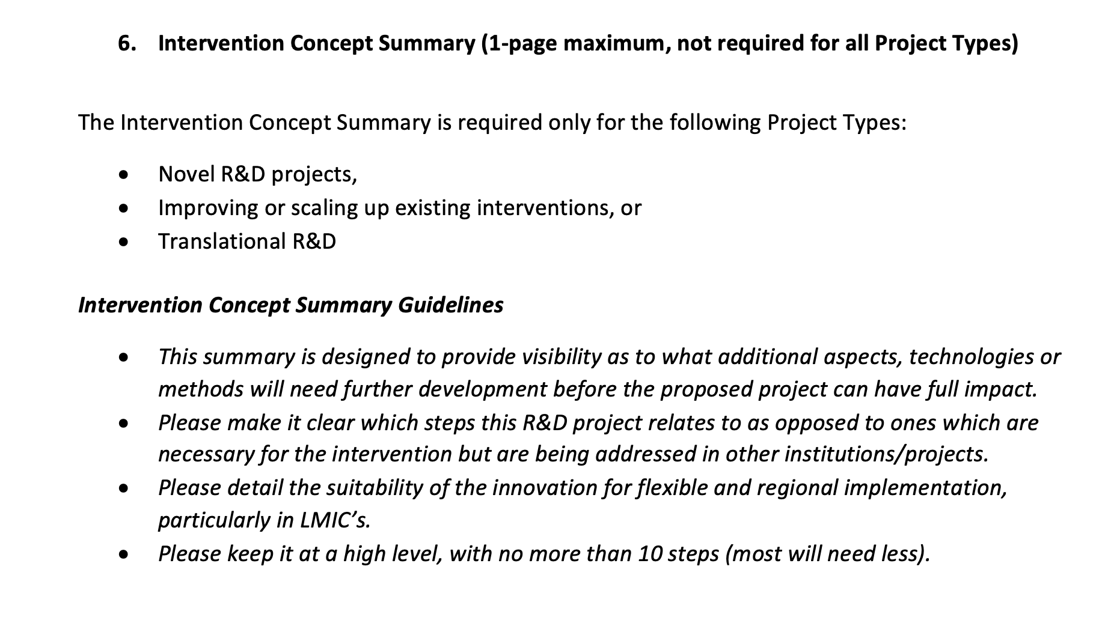
What is an Intervention Concept Summary?
Provide visibility as to which additional aspects, technologies, or methods will need further development before the proposed project can have full impact.
Make it clear which steps this R&D project relates to as opposed to ones which are necessary for the intervention but are being addressed in other institutions/projects.
From the “CORDAP CAP 2024 Concept Note Submission Form” Word document

Slide 17
CAP – Proposal Budget
The Lead Applicant/Lead Organization will receive the CORDAP funds for the entire consortium and has the responsibility of distributing the payments received from the granting authority to the co-applicants.
Indirect costs: The maximum total cost for indirect costs cannot be more than:
20% of the direct research costs if the applicant is based in a low- or middle-income country
10% of the direct research costs if the applicant is based anywhere else
The following budget items are eligible costs but not eligible for indirect costs calculation: Equipment and capital expenditures over $5K, rental costs, student tuition fees, scholarships and fellowships, and external services.
It is important to note that CORDAP is a charitable entity, funded by voluntary contributions, and does not have the financial capacity to match the indirect cost rates that national science funders may pay to their awardees.
Cost-sharing: Leveraging CORDAP funding with cash and/or in-kind contributions to the project are very much encouraged but not mandatory. You can elaborate on this in the Budget Justification section.

Slide 18
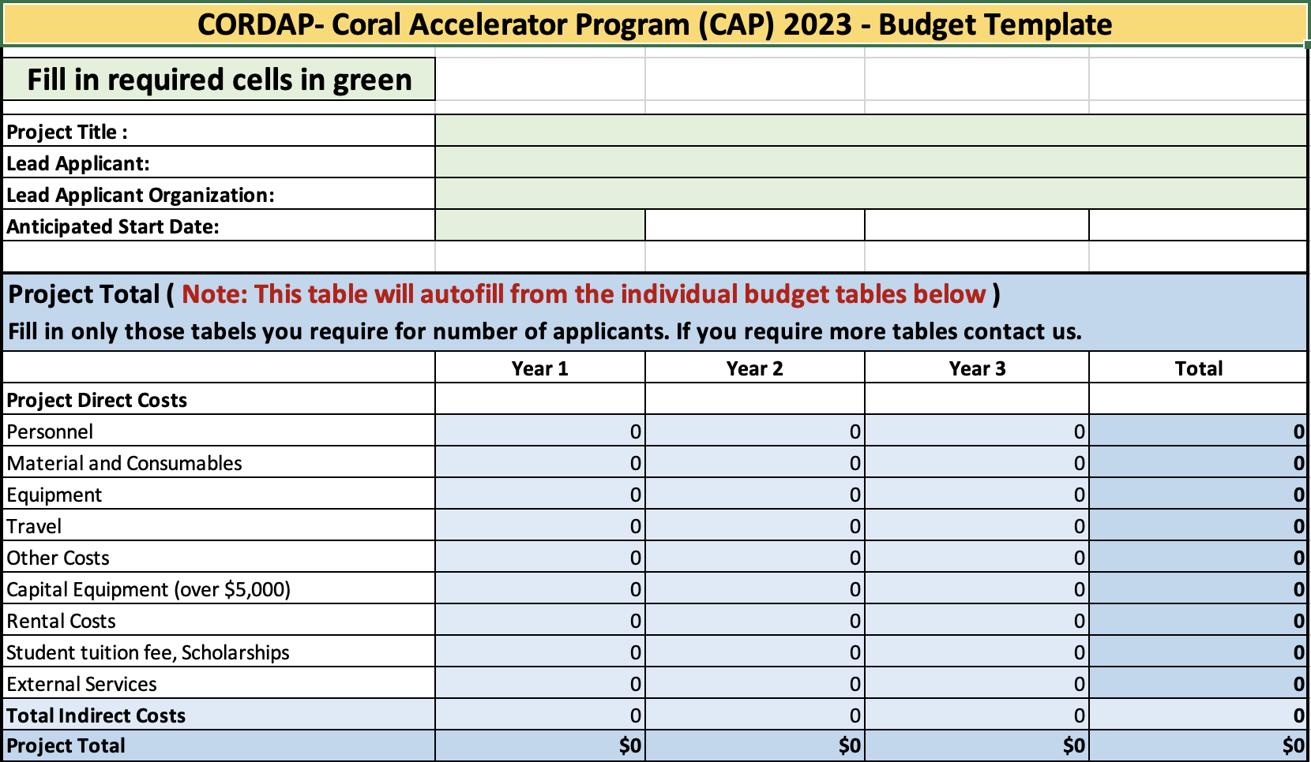
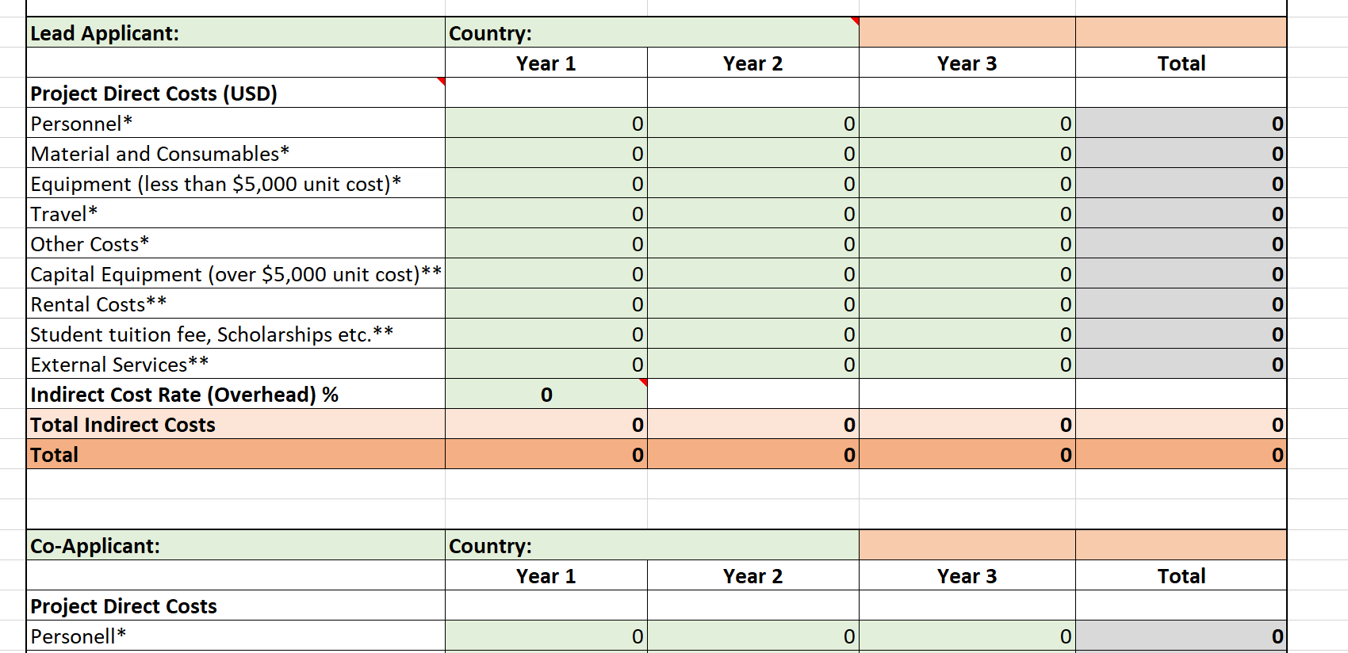
Proposal Budget: Budget Template
Complete cells in green shading, and the rest will autofill.
Fill in one table for each applicant/co-applicant requesting funding.

Slide 19
CAP – Proposal Budget
Budgets must be prepared using the supplied budget template: Excel file, with summary form-filled information.
Requested costs must be related to research and integrated educational activities directly related to the project.
There is a budget guidance sheet in the Excel file.
Equipment: It is expected that participating organizations will already be equipped to pursue their current research. Purchase of equipment essential for the proposed project is eligible. (renting is encouraged where cost-effective.)
  Capital Equipment (assets/equipment over US$5K):
    The proposed maximum allowable cost for any single unit of equipment is US$80,000.
    Sharing/Asset Ownership/plans after the award for large equipment requests.
Note: the type of equipment/materials requested, and their use, will be taken into account, for example laboratory equipment used simply to aid research vs. equipment and materials used to build novel prototypes.
Budget justification: Explain why items are essential in relation to the aims and methodology of the project as well as meeting the goals of the project. You should not merely restate the proposed expenditure. Detail provided should be commensurate with the amount of the requested line item. At the Concept Note stage you are trying to demonstrate to the Review Panel that your costs are reasonable, necessary, and provide good value for the funding requested without the requirement of a lot of detail.
NOTE: Budgets may be adjusted between Concept Note and Full Proposal stage, in particular if based on feedback from the review panel.

Slide 20
CAP – Reporting and Payment Schedule
Many organizations, particularly in developing countries, may not have the resources to take on much of the project costs in advance.
  This is reflected in the payment made upon signing the award contract.
Payments are lump-sum payments annually upon receipt of an annual report.
Any unspent funds must be returned to CORDAP at the end of the project.
Brief interim updates/highlights are required at regular intervals (quarterly).
 | Reporting deliverable | 1 Year Project | Up to 2 years | Up to 3 years
Upon Contract Signing/Before Project start |  | 50% of Project total | 40% of Project total | 30% of Project total
End of Year 1 | Progress/Final Report Financial Report | Financial Reconciliation – Payment of remainder of project funds spent. | 40% of Project Total | 30% of Project Total
End of Year 2 | Progress/Final Report Financial Report | NA | Financial Reconciliation – Payment of remainder of project funds spent. | 30% of project Total
End of Year 3 | Final Report Financial Report | NA | NA | Financial Reconciliation – Payment of remainder of project funds spent.

Slide 21

Consortium Agreement - NOTE: Not required at this stage – information for your organization
CORDAP makes the Award to the Lead Institution only.
Successful applicant organizations are required to sign a legally binding Consortium Agreement (amongst themselves) before funds are disbursed.
The Consortium Agreement sets the framework for a successful project implementation and is a private agreement between the participants to set out the rights and obligations amongst themselves. (It does NOT involve CORDAP.)
The Consortium Agreement details:
Project implementation and division of tasks, internal organization, and management of the Consortium,
Project budget and distribution of funding,
Rules on rights and obligations related to background and results, as well as liability,
IP management, exploitation and dissemination of results, and boilerplate provisions; duration, termination, communication, applicable law, and settlement of internal disputes, etc. must be addressed in the agreement.
A CORDAP template Consortium Agreement for applicants to modify for their team has been made available.

Slide 22
Proposal Evaluation Criteria and Process
2-stage application process - Applicants will first submit a Concept Note proposal (Pre-Proposal), which is reviewed by a panel of experts.
Applicants who are successful in the Concept Note phase of the call will be invited to submit a Full Proposal. Full proposals will undergo a full international 2-stage peer review: topic experts’ evaluation feeding into panel review.
All eligible applications will receive feedback from the Review Panel, whether invited to Full Proposal or not.
All proposals will be evaluated against the criteria below:
Qualifications and track record of the applicant teams and applicant diversity
Innovation or novelty of the idea
Potential of the project to make step changes and be transformative in its field
Targeted impact and pathway and timing to impact
Alignment with nominated R&D investment themes or areas
Management and coordination of the project
Cost-effectiveness of the proposed project
Broader impact and breadth of socioeconomic applicability
CORDAP will seek to fund a balanced and complementary portfolio of projects across the project type and priority areas to ensure a broad impact.

Slide 23
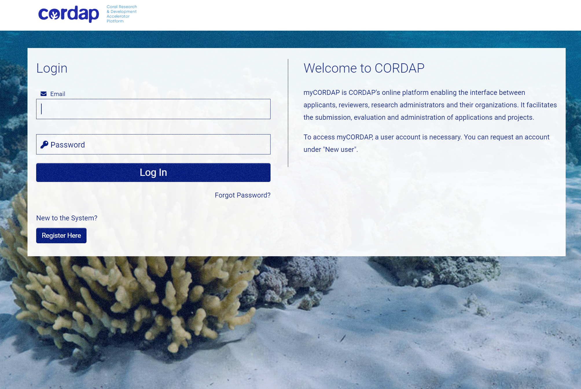
How do I apply?
All applications are made through our online submission system – myCORDAP
Only the Lead Applicant needs to register and complete the submission.
There is a submission help document on the website, “Concept Note Submission Assistance,” which will guide you through each stage of registration and submission.
At Concept Note stage, there are only two documents you need to complete and upload:
  Concept Note Submission Form Template
  Concept Note Budget Template
  The rest of the information is filled in directly on the myCORDAP system.
  You can save a draft application, leave/log off, and return to complete at any time.
  A “validate” function will check whether or not you have completed the required sections.
  You can delete an application and start a new one.

Slide 24
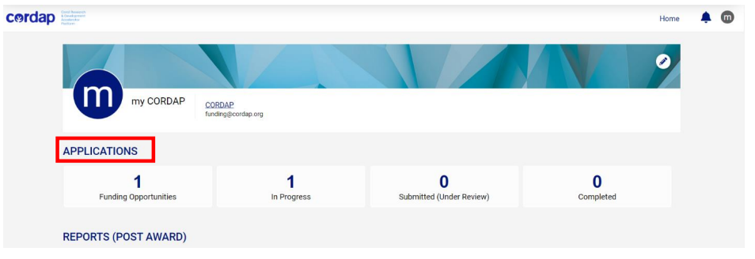
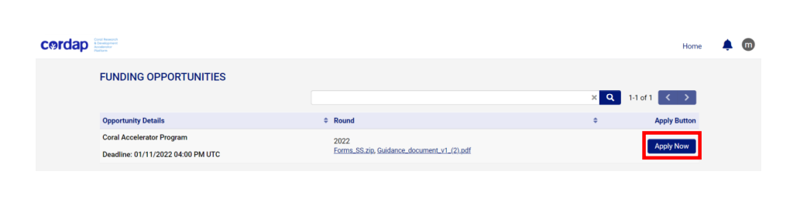
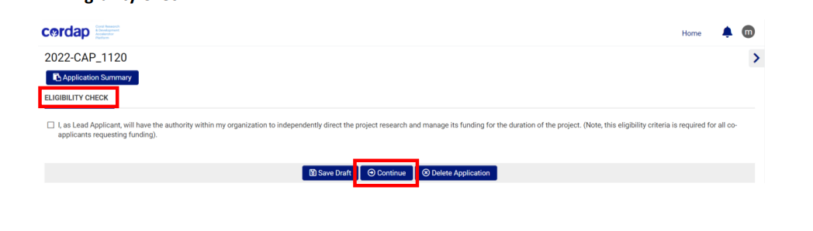
Online submission of a proposal
Once you have registered, you will be directed to your applicant dashboard:
You will see “Funding opportunities” here.
Before starting the application, you will be asked an eligibility question – ensuring you have the authority within your organization to independently manage the proposed project.

Slide 25
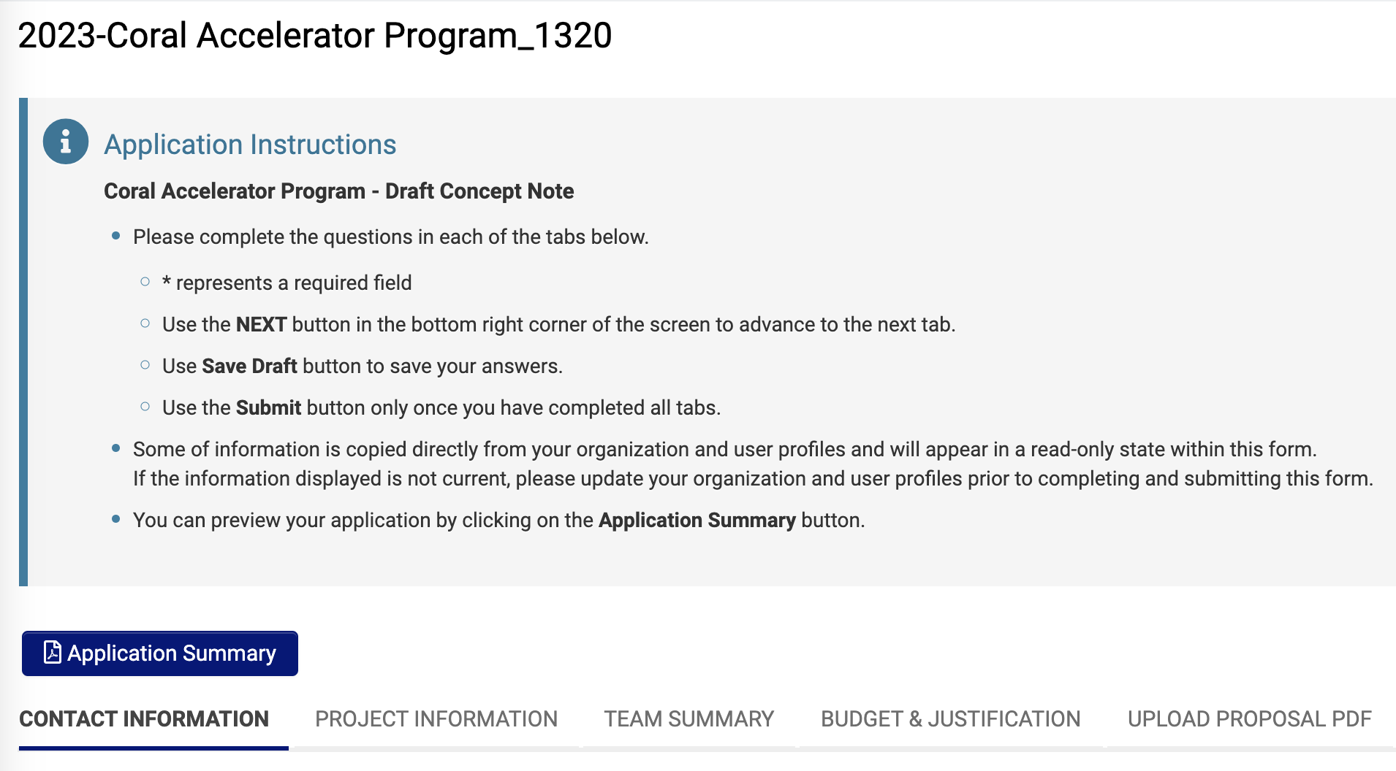
Online submission of a proposal

Slide 26
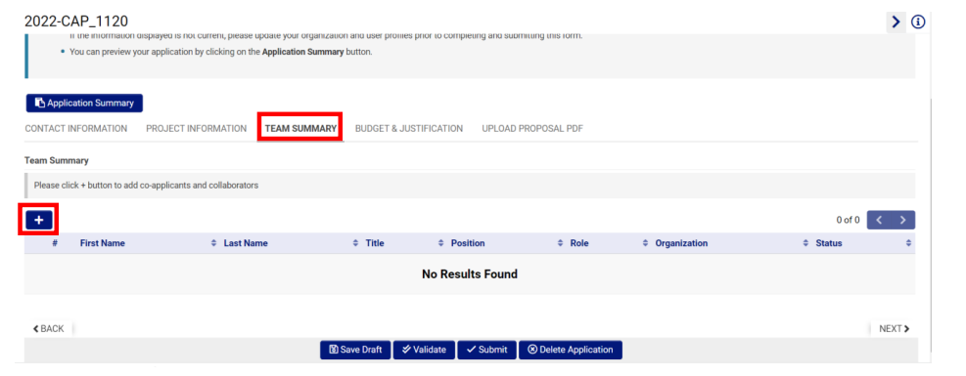
Online submission of a proposal – 5 Sections to complete
Contact Information
  This information will be pulled in from your registration.
Project Information
  Project Title
  Abstract: The abstract should summarize the significance (need) of the work, the hypothesis and major objectives of the project, the procedures to be followed to accomplish the objectives, what solutions will the project provide and what will be specific outcomes and the potential impact of the work.
Team Summary - Add co-applicant details here (co-applicant level only, or team lead/investigator level), more than one applicant can be entered from each participating organization if deemed at this level.

Slide 27
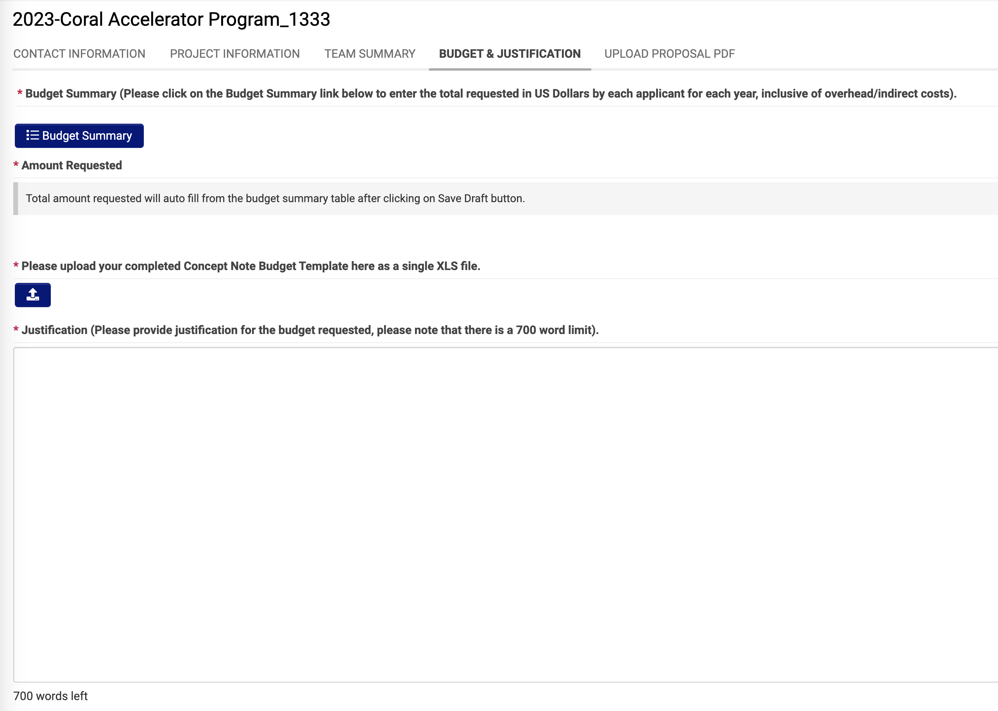
Online submission of a proposal – 5 Sections to complete
Budget & Justification
  Add high-level budget detail online, plus the budget justification.
  Upload completed Excel file here.
  Justification: Explain why items are essential in relation to the aims and methodology of the project as well as meeting the goals of the project.
    You should not merely restate the proposed expenditures.
    Details provided should be commensurate with the amount of the requested line item.
  At the Concept Note stage you are trying to demonstrate to the Panel that your costs are reasonable, necessary, and provide good value for the funding requested without the requirement of a lot of detail.
Upload Proposal PDF: Upload completed submission template here as a single file.
  Includes Lead and Co-Applicant CVs (see 2-page template within Concept Note Submission Form.)
And finally - you can Submit when your application is complete.

Slide 28
What makes a good proposal?
Innovative with high potential for impact or transformative advances
The solution is broadly applicable – not specific to your location or circumstances
Demonstrated knowledge of the field - why is your idea better?
All the required expertise is covered – all team members are required
Clearly states the problem, solution, approach, objectives, and work plan (if features multiple parts, bring ideas together to form a single coherent proposal)
For translational/development projects – know what else is needed!
Ambitious yet realistic – time frame/resources
Good management of the project – address the risks!!

Slide 29

If I want to apply, what should I do first?
Put the team together –
Develop your ideas – think about how the outputs of a successful project would be used; are users/stakeholders involved in developing the project?
Are the ideas scalable and transferrable? Explore the risks.
Develop a first draft ASAP – don’t leave it until the last minute!
All documentation/updates will be available at cordap.org
Further queries can be sent to funding@cordap.org

Slide 30
THANK YOU
Questions Welcome

Slide 31
Back Up Slides/
Additional Information

Slide 32




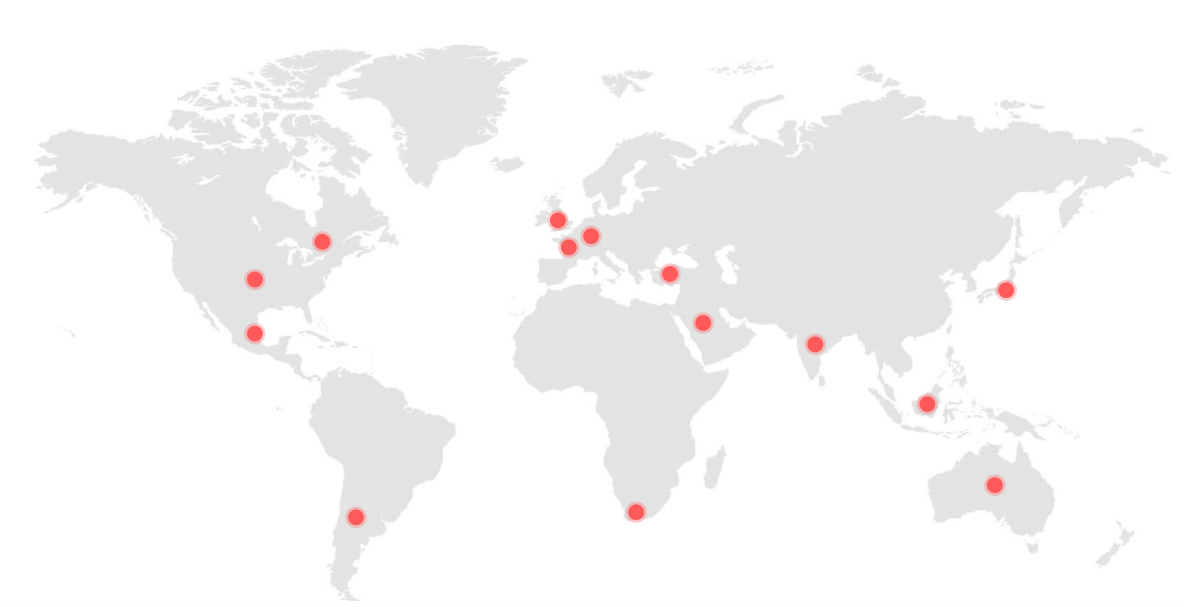







Members and Partners
Indonesia
Japan
Mexico
Saudi Arabia (Chair)
South Africa
Turkey
United Kingdom
United States of America (Vice Chair)
Argentina
Australia
Canada
European Union
France
Germany
India

Slide 33

Resourcing the R&D Programs
Saudi Arabia has generously committed US$100M ( $10M/Year for 10 years) as a founding contribution to the platform.
KAUST funds the administration of the Platform – all donated funds go to projects!
With a target of US $300M, CORDAP aims to raise and deploy an additional US$200M for research, development and pilot implementation of scalable, affordable solutions to coral restoration and survival.
To do this, CORDAP will seek resourcing partnerships with
  G20 and other states around the world to build on our founding commitment
  Philanthropies, Foundations, Corporate and private funding sources
Coral research community can help significantly, using networks and contacts in ministries, organizations- more funding translates to more funding programs, more projects, bigger and quicker impact!

Slide 34
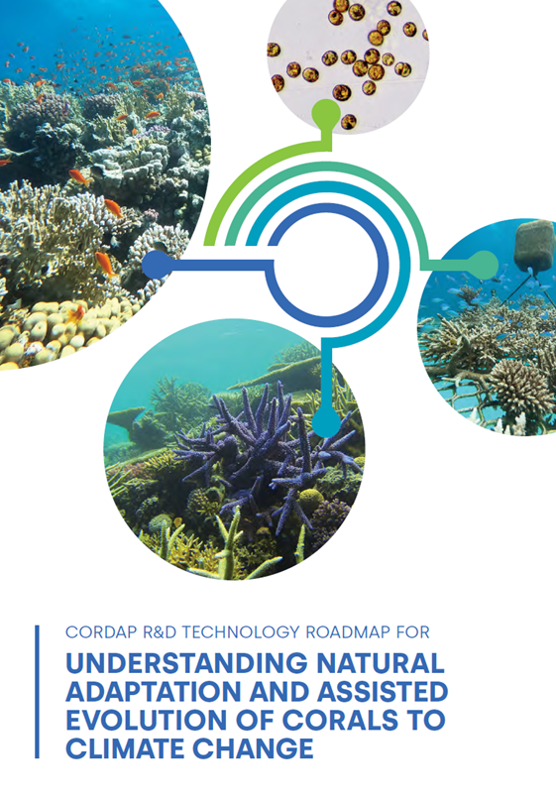

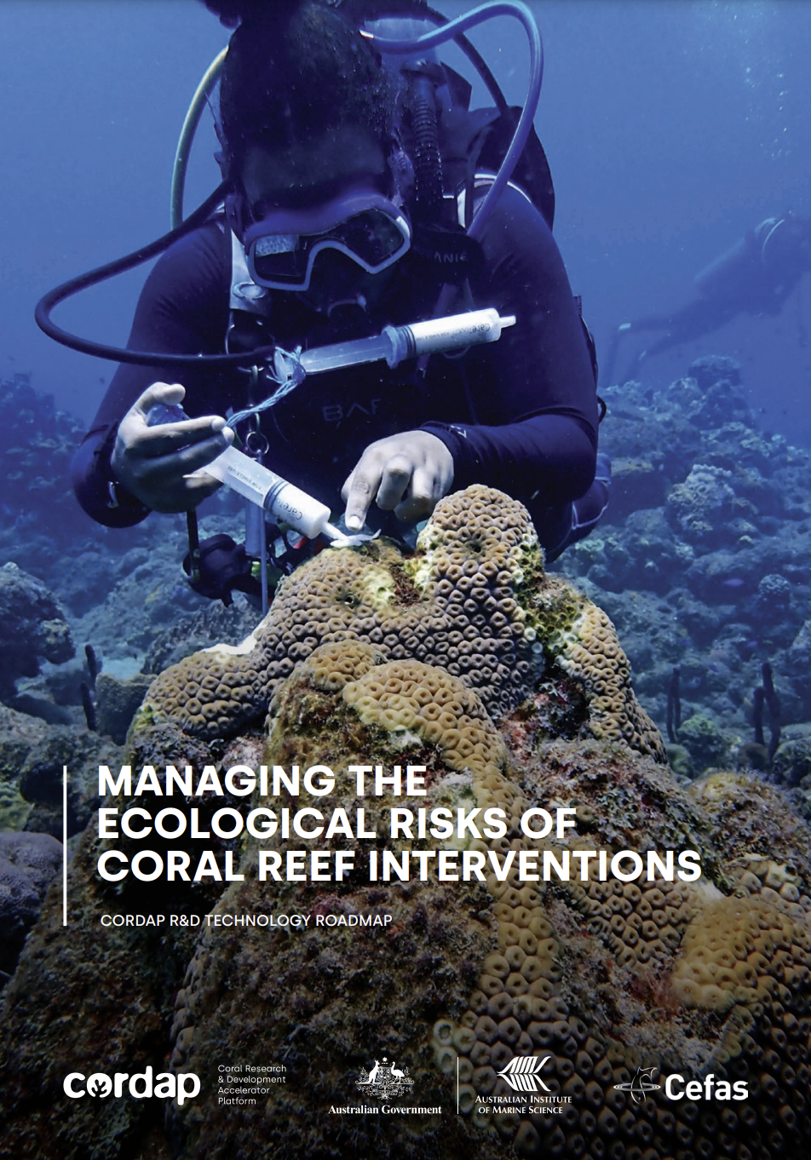
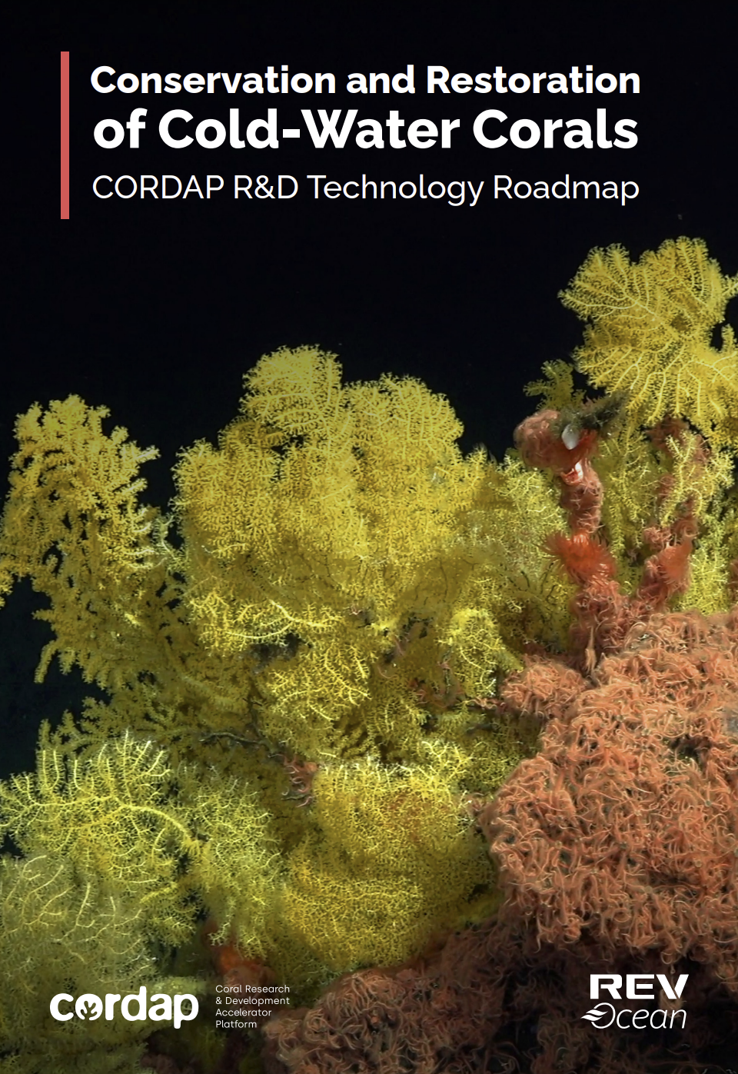
CORDAP Scoping Studies– Technology Road Maps - https://cordap.org/studies-roadmaps/
CORDAP Scoping Studies are short-term (< 6 months) activities, centered around a workshop, that bring together world experts in relevant topics, with the outputs being:
Summary of current knowledge
Recommended priorities and options for funding and investment
Technology Roadmaps to help align and guide global R&D efforts in the area
Coral R&D Capacity Development
Helping to build the research, development, and technical capacity of developing nations.
Workshop was held in Mombasa, Kenya, March 12-14th 2024.
Natural Adaptation and Assisted Evolution of Corals
Workshop hosted at KAUST, Saudi Arabia with AIMS, 24-27th Jan 2023
Coral Aquaculture (Innovative Technologies for Reef Restoration)
Workshop hosted by CORDAP and KAUST Reefscape Restoration Initiative at KAUST, Saudi Arabia, 2023
Managing Ecological Risks of Coral Reef Interventions
Workshop hosted by AIMS and held in Brisbane, Australia from 22nd to 25th of January 2024.
Cold Water Corals - Conservation and Restoration
Workshop held in Oslo, Norway hosted by RevOcean, May 10-12th 2023

