Slide 1
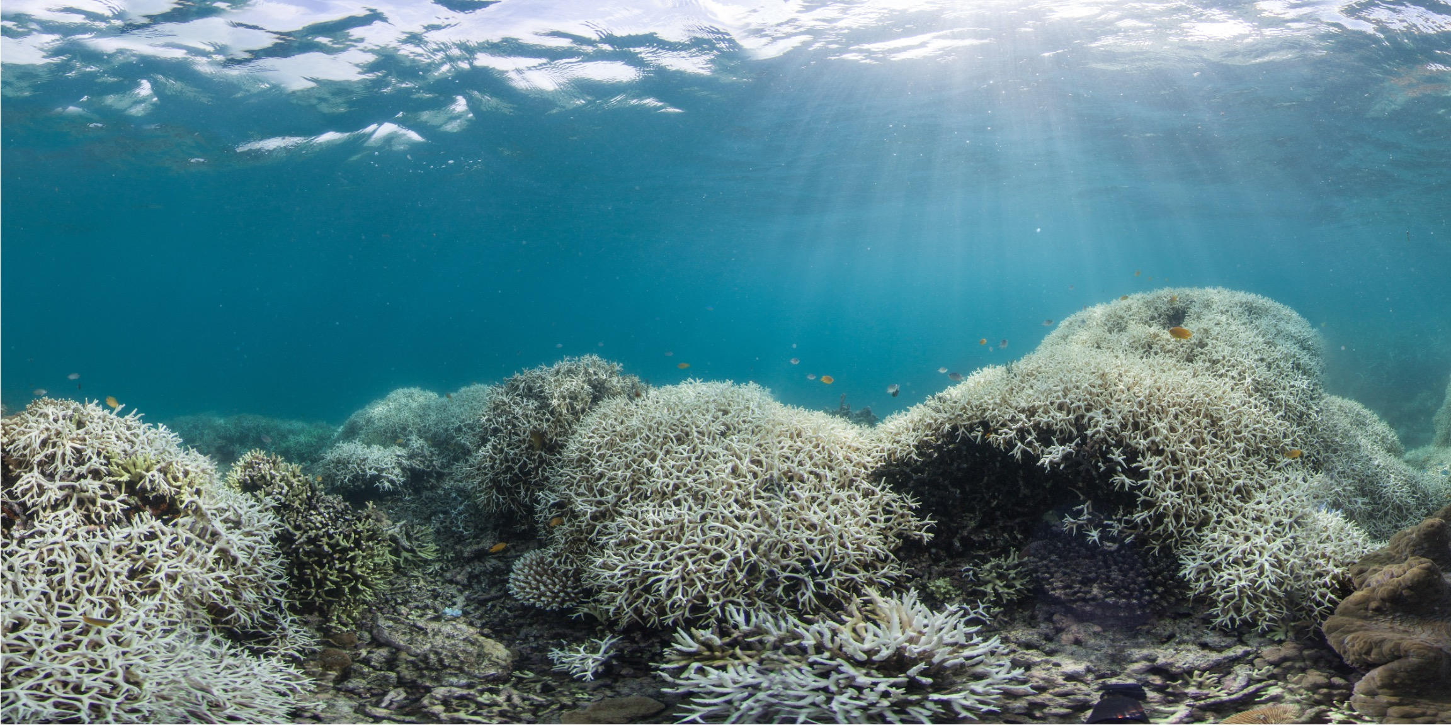


Corals can still have
a future
– if we act now.
Coral Accelerator Program
Full Proposal Deadline: February 16, 2026 (6:00 PM UTC)

Slide 2
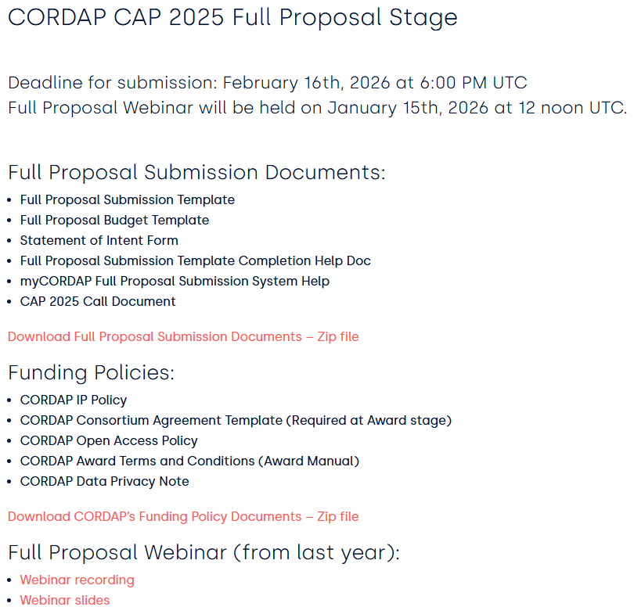
Full proposal documents are available at:
https://cordap.org/full-proposal-docs-cap2025/.
Welcome to Full Proposal Webinar
This webinar will be recorded and a link placed on:
https://cordap.org/full-proposal-docs-cap2025/.
Please submit questions through the chat – we will go through the questions at the end of the slides (with some answered as they come in).
If we do not get to all questions today, we will update the FAQ with the outstanding queries.
For questions related specifically to your review feedback, email pcn@kaust.edu.sa.

Slide 3

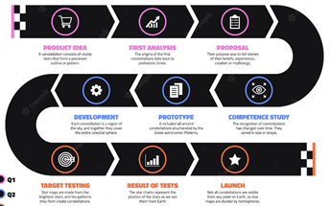
CORDAP’s Coral Accelerator Program (CAP) 2025: Objectives and Goals
Technologies and methods that can be applied in conservation and restoration efforts across the world.
Innovation crucial to filling the gap between current & required global capabilities.
Projects funded under this program should lead to significant discoveries, innovations, and improvements over the current state-of-the- art.
Proposals transcending different disciplines and fields, and including end users in the research, design, and development, are encouraged- identify suitable partners that can further develop+deploy the proposed technologies.

Slide 4
CORDAP has funded 29 projects to date
315 proposals received (>1,500 applicants)
Funding 37M/380M requested (~10% Success rate)
We are funding research teams in 41 countries:
28 developing (Low and Middle Income Countries)+13 developed
~60/40% developed/developing country funding breakdown
https://cordap.org/projects-awarded/

Slide 5

Coral Accelerator Program (CAP) 2025 ​ Program Updates​
Total number of proposals received :155
Number of Eligible Proposals Received​: 122
Total number of applicants ( Inc. co-apps):​ 761​
Total number of countries involved​: 76​
Total Number of LMIC Countries​: 47​
Proposals Led by LMIC Countries​: 40​
Number of Female Lead Applicants​: 40​
Number of Female applicants in total​: 310​
Total applications invited for FP​: 17
Total funding requested (M USD)​: $155 ​

Slide 6
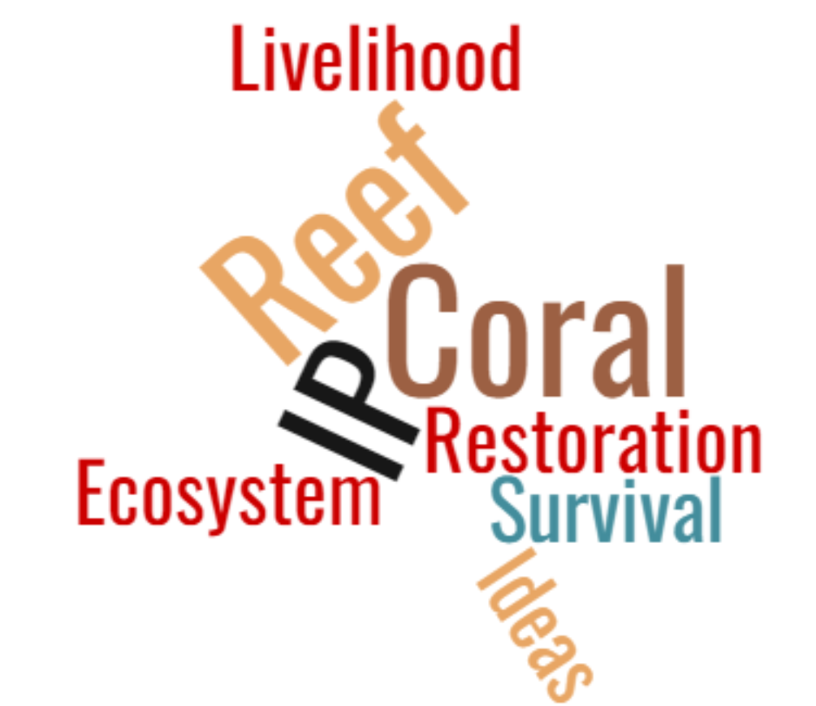
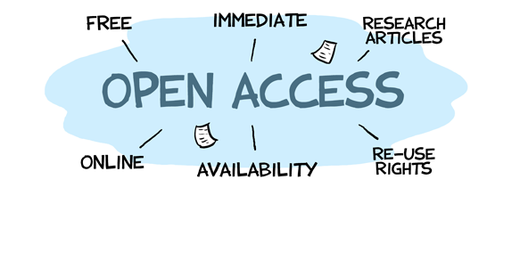
CORDAP Funding Policies
Intellectual property
CORDAP does not seek to own any of the IP resulting from its funded activities. Ownership vests as agreed by the collaborating organizations.
Owners of IP resulting from CORDAP-funded activities must provide a free license for all commercial and non-commercial coral conservation/restoration use, including free license to any background IP upon which the project relies.
CORDAP-funded developments and technologies should be made available and accessible at an affordable price to all coral conservation and restoration projects.
Open-access
Publications, and underlying data, will be immediately, freely, and openly accessible to all.
There should be no barriers to the re-use and dissemination of CORDAP-funded publications.
CORDAP will pay necessary reasonable fees to ensure open access.
Research data and software should be “Findable, Accessible, Interoperable & Reusable” (FAIR).

Slide 7
How is the full proposal different from the concept note?
A concept note is a shorter statement of your project objectives, methodology, intended users, and estimated budget.
The full proposal is a more detailed version, incorporating concept note panel feedback and including formal organization sign-off(s) on all aspects of the proposal and agreement to CORDAP policies.
Full Proposal Sections:
The Project Narrative: 8-page maximum. We are strict with the page limits!!!
Background and motivation
Aims and objectives
Strategy and work plan
Impact, knowledge transfer, and success
Intellectual property
Things to look out for:
Ensure you cover the current state-of-the-art and developments in the field.
Cover all risks & potential mitigation actions, in particular early risks in a project.
Emphasize full engagement of low-middle-income country (LMIC) partners.

Slide 8
How is the full proposal different from the concept note?
Full Proposal Sections:
The Project Narrative
Project Management Plan – 3 pages
Overall project management and collaboration plan
Risk assessment and management
Summary of key deliverables
Gantt chart
An Intervention Concept Summary is required for project types: (additional 2 pages maximum)
• Novel R&D projects

Slide 9
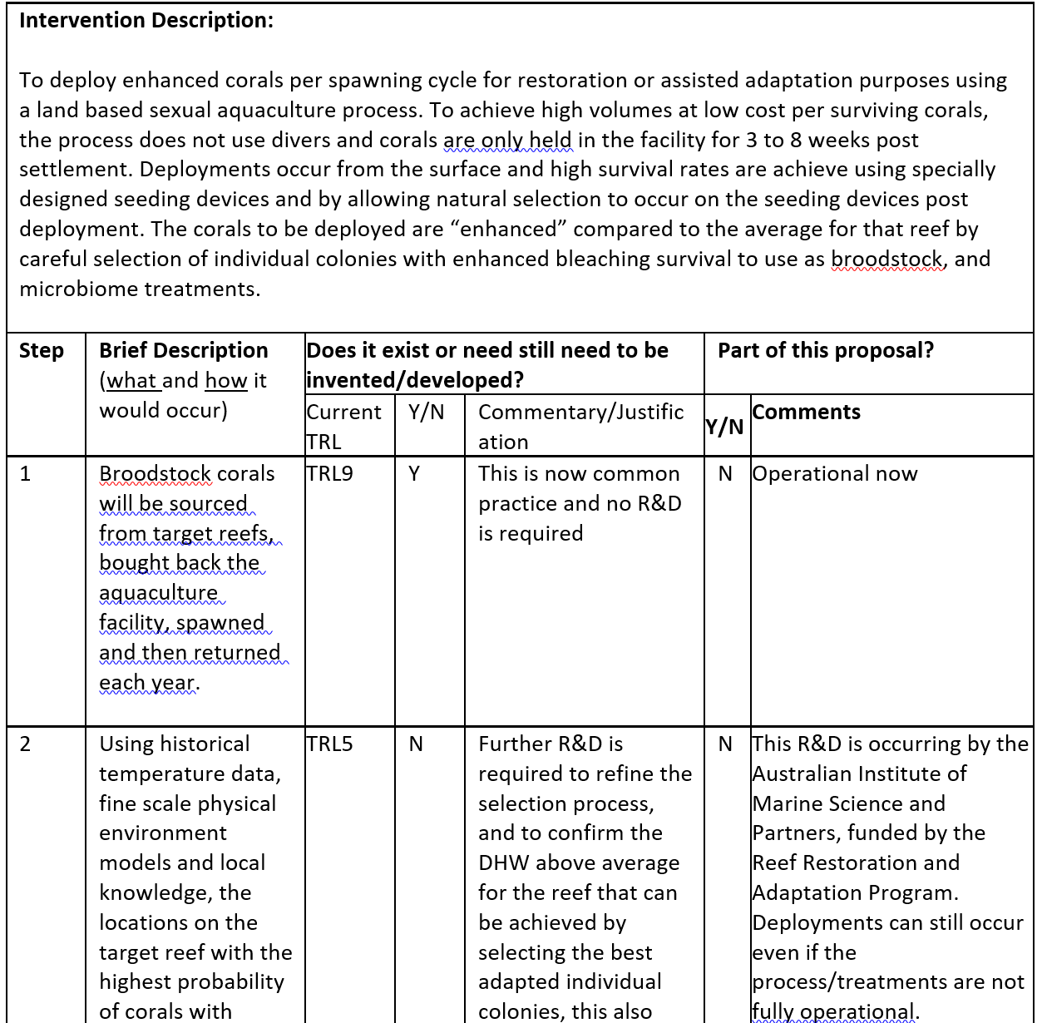
What is an “intervention concept summary?”
Example
Provide visibility as to what additional aspects, technologies, or methods will need further development before the proposed project can have full impact.
Make it clear which steps YOUR project relates to as opposed to ones which are necessary but are being addressed by other institutions/projects.
Do the other required “bits” for your idea to work exist now?
TRL level not required but useful.

Slide 10
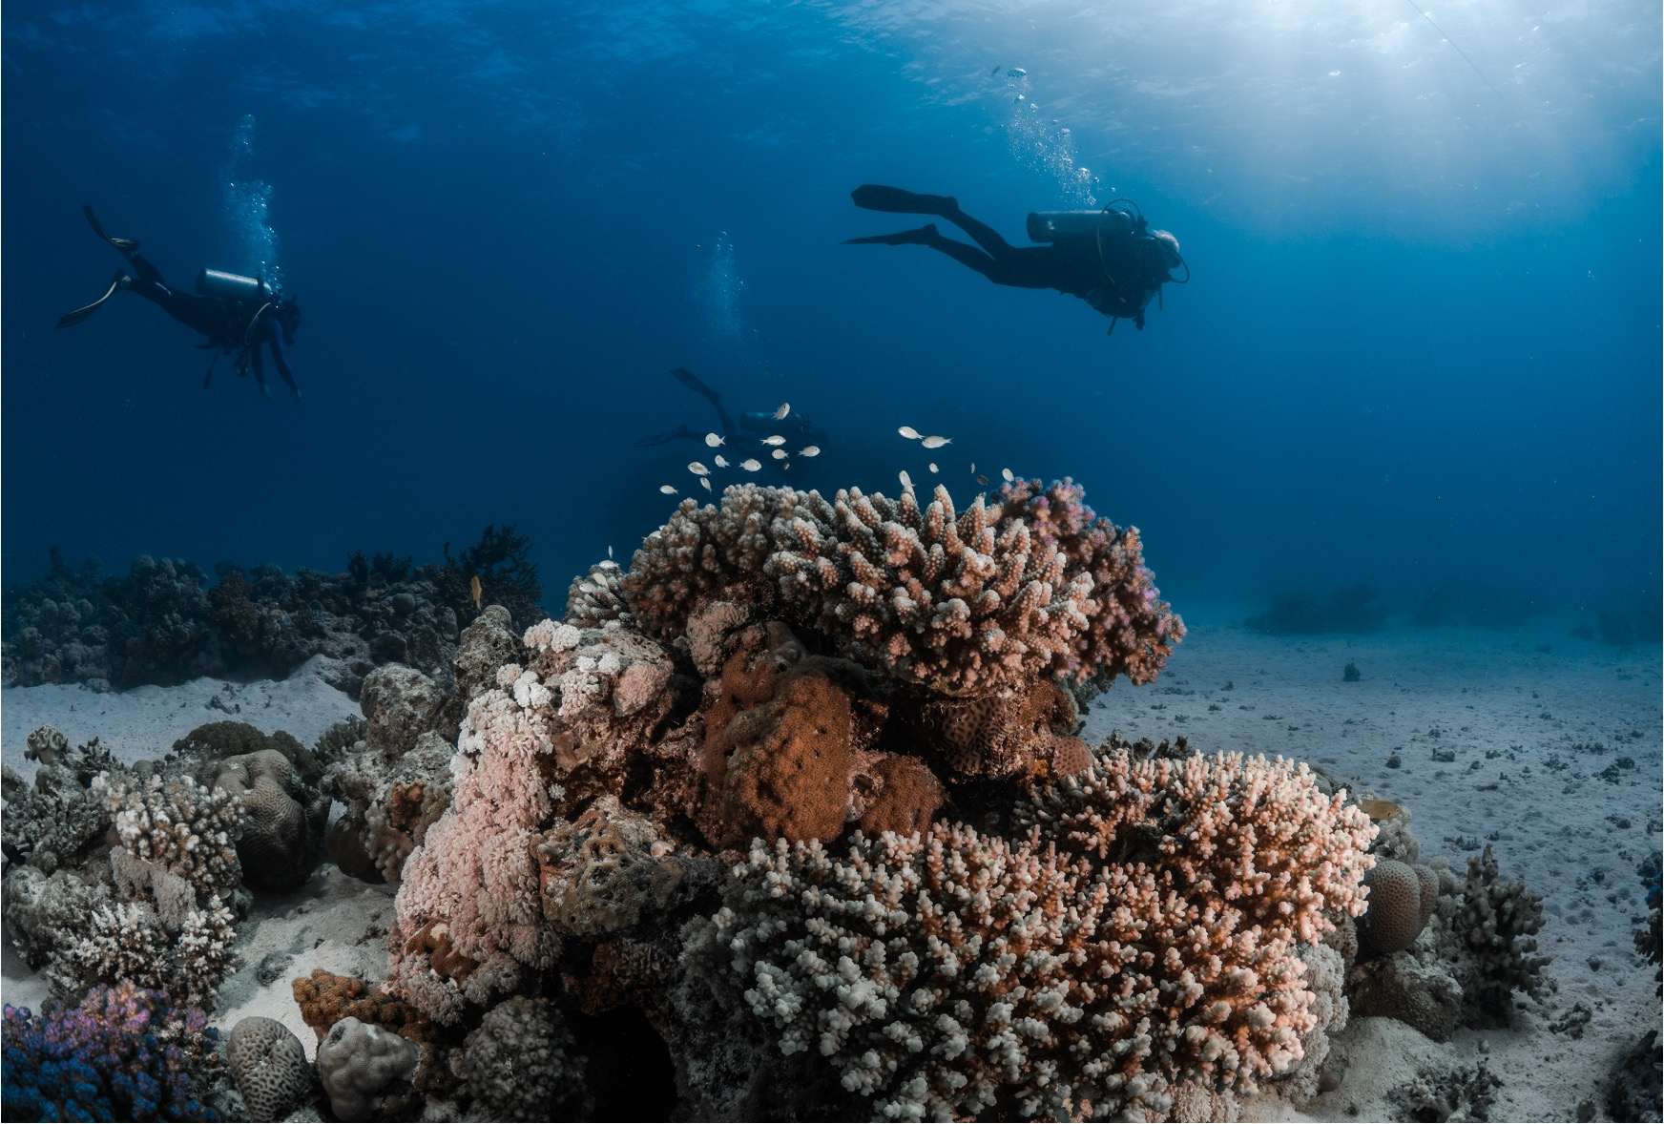
How is the full proposal different from the concept note?
Gantt Chart
Add/remove number of tasks as needed. Indicate person(s) or team(s) responsible for the task (you don’t have to use our template).

Slide 11
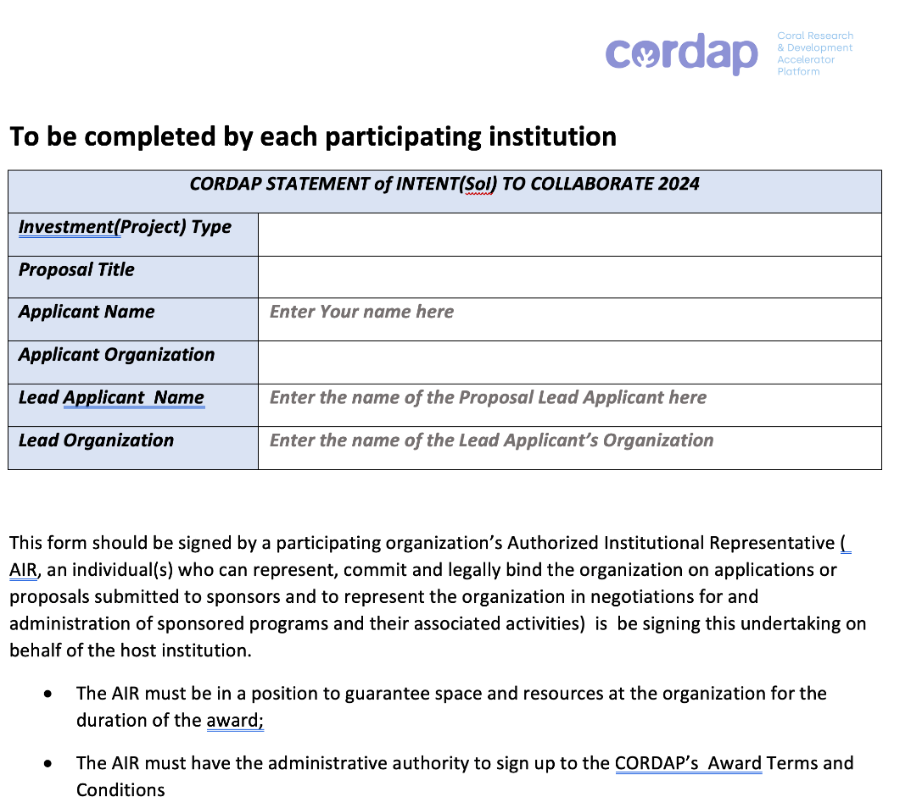
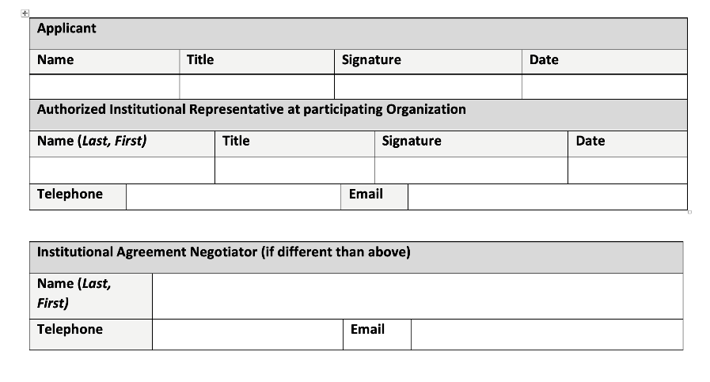
State of intent to collaborate (SOI)
This was mentioned at the concept note stage, but it’s required at the full proposal stage.
Lead organization accepts all funds.
Must be signed by all authorized institutional representatives.
Get started on this ASAP (!!) as it can take a while.
Remember, the authorized institutional representative is oftentimes NOT the lead PI (except perhaps for smaller NGOs).

Slide 12
CAP – Proposal Budget
Budgets must be prepared using the supplied budget template: Excel, with summary form fill information
Requested costs must be related to research and integrated educational activities directly related to the project. There is a budget guidance sheet in the Excel file.
Equipment: It is expected that participating organizations will already be equipped to pursue their current research. Purchase of equipment essential for the project proposed is eligible (though renting encouraged where cost-effective).
Capital Equipment (assets/equipment over US$5K):
The proposed maximum allowable cost for any single unit of equipment is US$80,000.
Sharing/asset ownership plans post-award for large equipment requests.
Notes:
Budgets may be adjusted between concept note and full proposal stage, particularly if based on feedback from the
panel.
2. Cost-sharing: Leveraging CORDAP funding with cash and/or in-kind contributions to the project are encouraged but
not mandatory. A dedicated section for outlining cost-sharing will be included in the application, though in-kind
contributions will not be financially quantified.
3. Percentage of budget going to developing countries should be taken into consideration.

Slide 13
CAP – Proposal Budget Justification
Budget & Justification
Add budget details online, including pertinent details in the “budget justification” area.
Upload completed Excel file.
Justification: Explain why items are essential in relation to the aims and methodology of the project as well as meeting the goals of the project. You should not merely restate the proposed expenditure.
Detail provided should be commensurate to the amount of the requested line item.
You are trying to demonstrate to reviewers that your costs are reasonable, necessary, in line with your activities, and provide good value for the funding requested.
A greater breakdown of costs is required at the full proposal stage.
Breakdown travel costs and differentiate between travel costs for meetings/conferences etc. vs. field work.
New section in Excel file – budget broken down by task – please estimate this as closely as possible, acknowledging the fact that resources may be shared between tasks.

Slide 14
CAP – Reporting and Payment Schedule
Many organizations, particularly those in developing countries, may not have the resources to undertake much of the project costs in advance; this is reflected in the payment made upon signing the award contract
Payments are lump-sum payments annually upon receipt of an annual report.
Any unspent funds must be returned to CORDAP at the end of the project.
Brief interim updates are required quarterly, with a more detailed annual report required, as well.
 | Reporting deliverable | 1 year project | Up to 2 years | Up to 3 years
Upon contract signing |  | 50% of project total | 40% of project total | 30% of project total
End of Year 1 | Progress/ Final Report, Financial Report | Financial reconciliation – payment of remainder of project funds. | 40% of project total | 30% of project total
End of Year 2 | Progress/ Final Report, Financial Report | NA | Financial reconciliation – payment of remainder of project funds. | 30% of project total
End of Year 3 | Final Report, Financial Report | NA | NA | Financial reconciliation – payment of remainder of project funds.

Slide 15

Consortium Agreement - NOTE: not required at this stage
CORDAP makes the award to the lead institution only.
Successful applicant organizations are required to sign a legally binding consortium agreement (among themselves) before funds are disbursed.
This agreement sets the framework for successful project implementation and is a private agreement between the participants to set out the rights and obligations amongst themselves; it does NOT involve CORDAP.
Consortium agreement details:
Project implementation and division of tasks, internal organization, and management of the consortium
Project budget and distribution of funding
Rules on rights and obligations related to background, results, and liability
IP management, exploitation and dissemination of results, and boilerplate provisions: duration, termination, communication, applicable law, and settlement of internal disputes, etc., must be addressed.
A CORDAP template consortium agreement for applicants to modify for their team is available.

Slide 16
Proposal evaluation criteria and process
Full proposals will undergo a full international two-stage peer review (topic experts’ evaluations feeding into panel review).
All eligible applications will receive feedback from the review panel, whether funded or not.
The review criteria remain the same as for the concept note stage:
Qualifications and track record of the applicant teams and applicant diversity
Innovation or novelty of the idea
Potential of the project to make step changes and be transformational in its field
Targeted impact and pathway and timing to impact
Alignment with nominated R&D investment themes or areas
Management and coordination of the project
Cost-effectiveness
Broader impact and breadth of socioeconomic applicability
CORDAP will seek to fund a balanced and complementary portfolio of projects across the project type and priority areas to ensure a broad impact.

Slide 17
Some important points to note
Innovative with high potential for impact or transformative advances – is it transferable?
The solution is broadly applicable – not specific to your location or circumstances.
Demonstrated knowledge of the field – state-of-the-art and existing solutions - why is your idea better?
All required expertise is covered – all team members are required, integrated into the plan, and have input to the proposal; the budget should reflect this – in particular developing country team members.
Clearly states the problem, solution, approach, objectives, and work plan (if featuring multiple parts, bring ideas together to form a single coherent proposal).
For translational/development projects, know what else is needed!
Clearly state the IP situation where required.
Good management of the project – address the risks, both technical and operational!
Where relevant, discuss potential long-terms plans for your solutions.

Slide 18
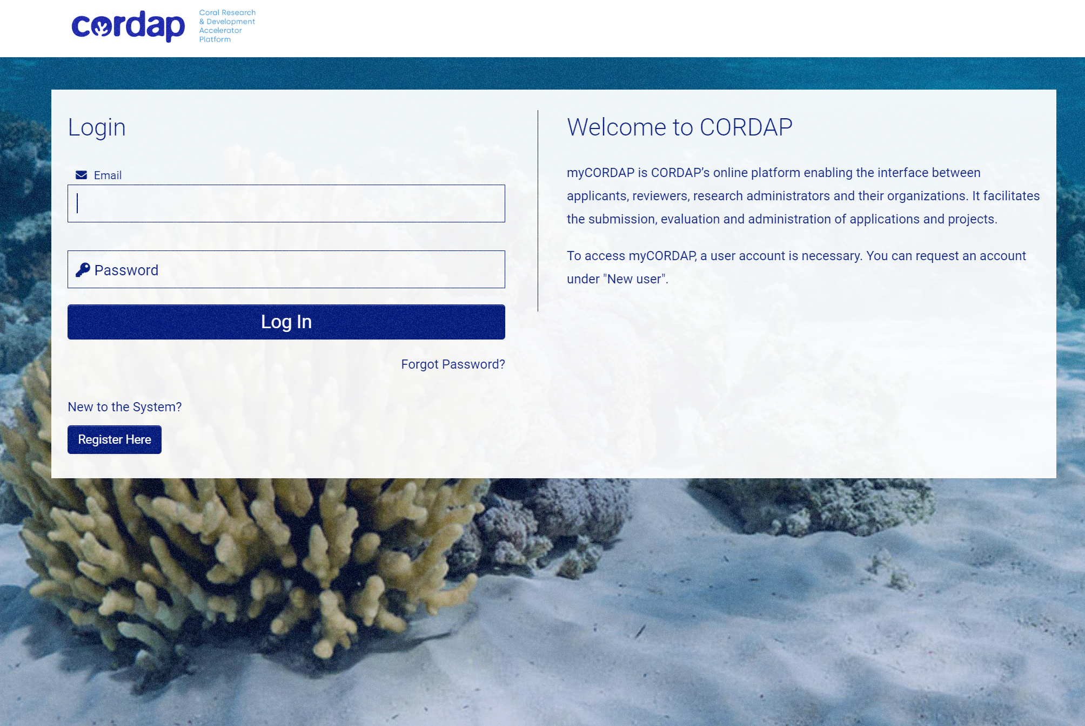
How do I submit a full proposal?
All applications are made through our online submission system – myCORDAP
Only the lead applicant needs to register and complete the submission.
There is a submission help document on the website (Submission Assistance), which will guide you through each stage of registration and submission.
At the full proposal stage, there are three documents you need to complete and upload:
Full Proposal Submission Form Template
Full Proposal Budget Template
Combined Statement of Intent forms
Optional (Letters of Support)
The rest of the information you filled in for the concept note will be pre-populated for you to edit.
You can save a draft application, leave, and return to complete at any time.
The “validate” feature will ensure that you have completed the required sections.
You can delete an application and start a new one.

Slide 19
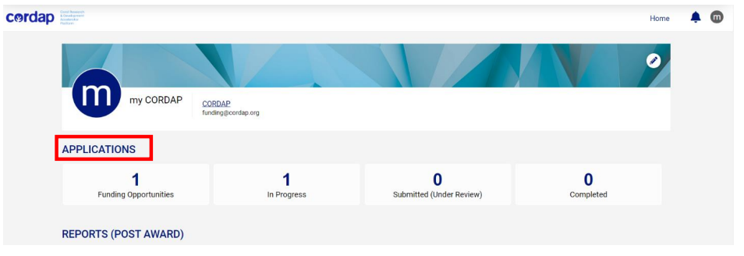
Online submission of a full proposal
Once you have registered, you will be directed to your applicant dashboard:
The full proposal will be available in the “In Progress” tab.

Slide 20
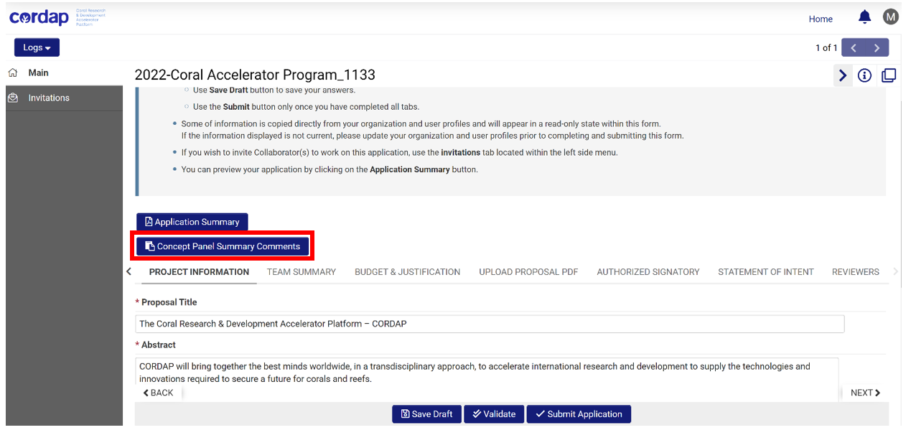
Online submission of a proposal
You can view the feedback on your concept note by clicking on the “Concept Panel Summary Comments” button.
“Invitation” is a feature that allows the lead applicant to invite and give co-applicants access to the proposal draft submission system to edit and complete sections, but they will not have the ability to submit the proposal.
You can add up to three suggested reviewers who have relevant expertise to review your application. You can also add names of restricted reviewers whom you wish we do not contact.

Slide 21




Help us secure a future for the world’s corals.
www.cordap.org
@cordap_
pcn@kaust.edu.sa
THANK YOU
Questions
Welcome

